Slide 1
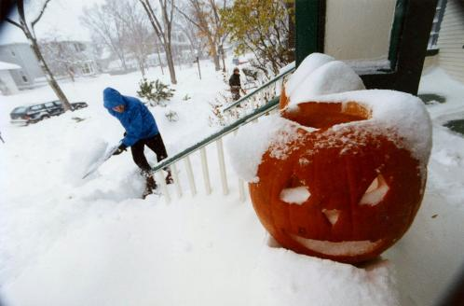
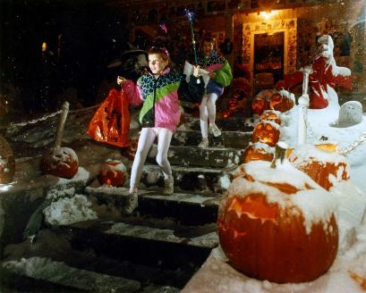
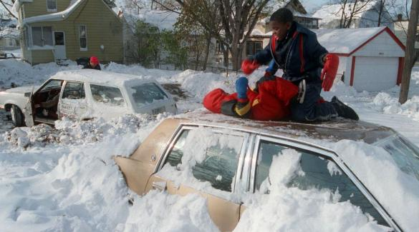
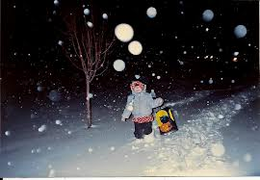
Happy Halloween!

Slide 2
The End of Fossil Fuels
Alternate Energy Summary

Slide 3
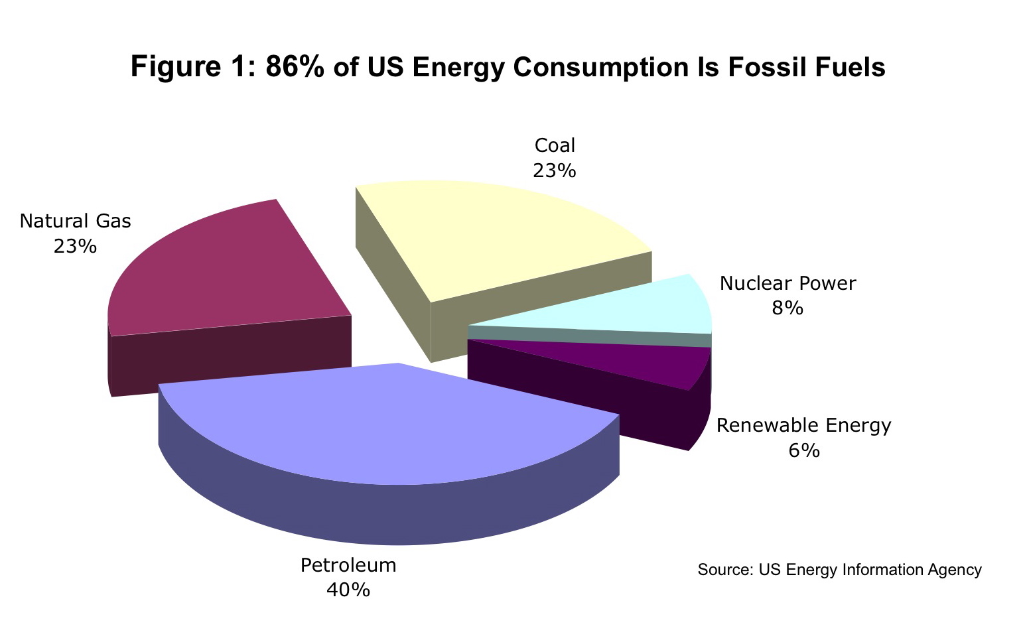
Our Current Energy Usage

Slide 4
Maintaining the Same Course
In the future, fossil fuels will become more and more scarce, and the cost of them will increase until only the very wealthy can afford them.

Slide 5
Future Trends
We will need to transfer from Petroleum and Coal based products to alternative forms of energy if we want to continue with our current lifestyles.

Slide 6
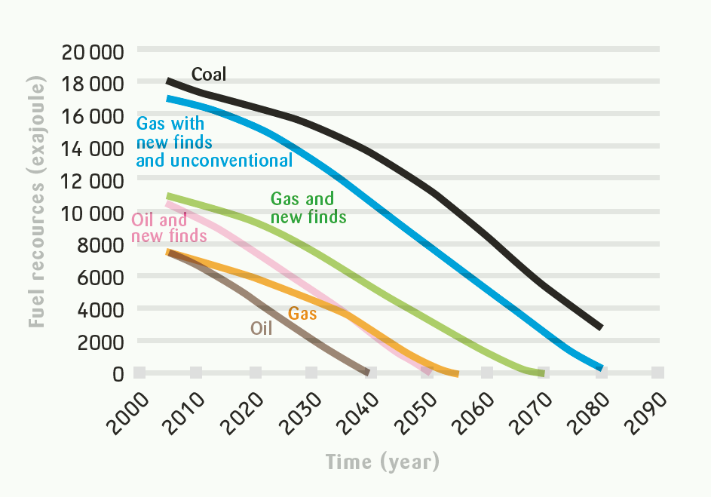
Remaining Fossil Fuels?

Slide 7
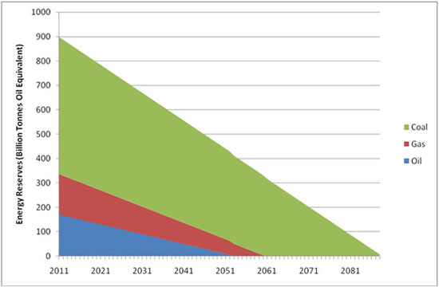
Remaining Fossil Fuels?

Slide 8
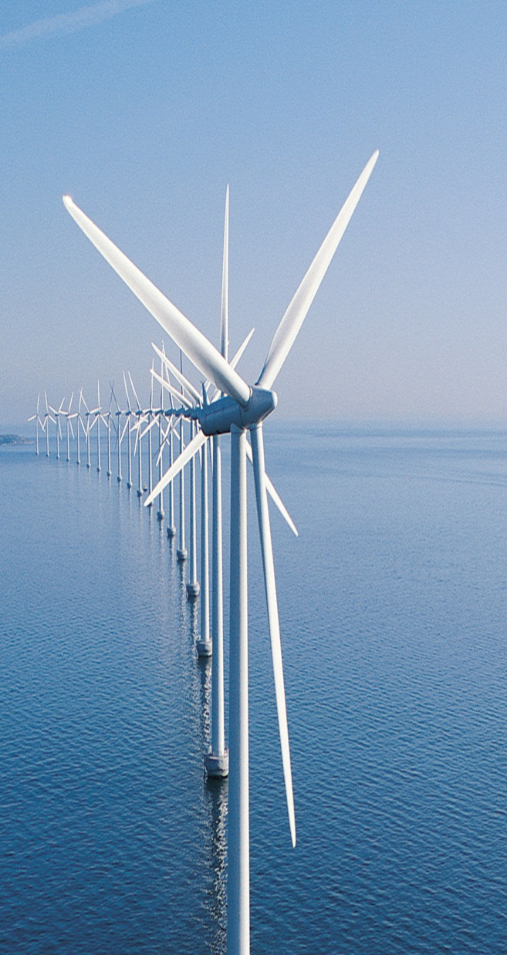
6 types of Alternative Energy
Wind Energy:
Clean, renewable energy source
No Pollution
Only works when wind blows
Large installations needed

Slide 9
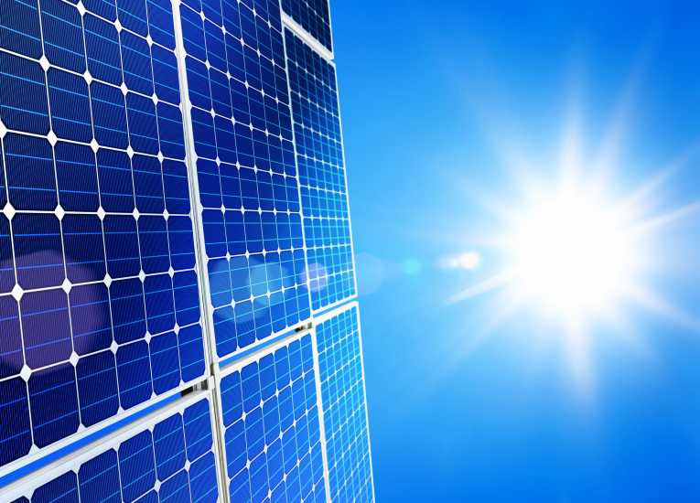
6 types of Alternative Energy
Solar Energy:
Quiet and renewable
May be placed on rooftops
Not reliable
Expensive start-up cost

Slide 10
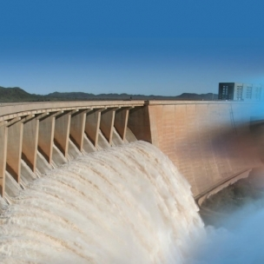
6 types of Alternative Energy
Hydro and Tidal Energy:
Efficient and reliable
Low Maintenance costs
Does not work everywhere
Alters fish migration routes

Slide 11
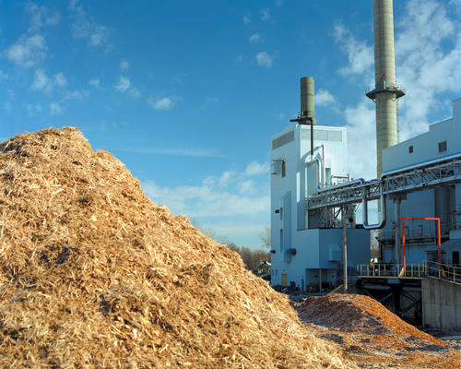
6 types of Alternative Energy
Biomass Energy:
Renewable and abundant
Many sources may be used
Still has a waste product
Pollution a worry

Slide 12
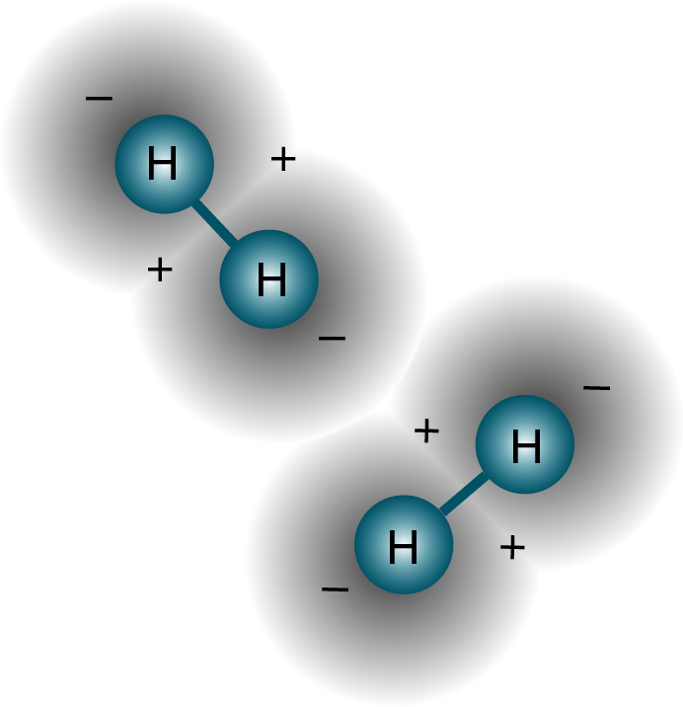
6 types of Alternative Energy
Hydrogen Energy :
May be taken from many sources
Water Vapor only by-product
Expensive to make fuel cells
Hydrogen is Flammable!

Slide 13
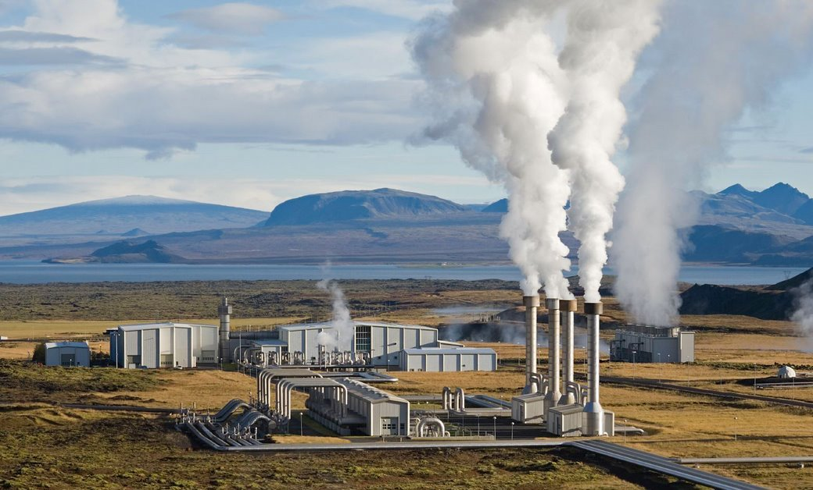
6 types of Alternative Energy
Geothermal Energy:
Very efficient and reliable
Used for heating and electricity
Not available everywhere
High start-up costs

Slide 14
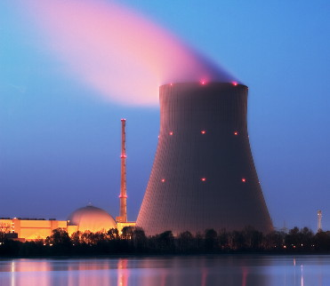
One Last Option
Nuclear Energy:
Efficient and proven
Available everywhere
Waste product dilemma
Safety issues

Slide 15
What would you do?
You may do this alone or with one other person.

Slide 16
Alternative Energy Quiz 20 points
The year is 2063 and you have been elected Leader of the Free world. Your #1 priority is to stabilize the energy market.
You know you cannot rely on fossil fuels, so you have to take a new direction.

Slide 17
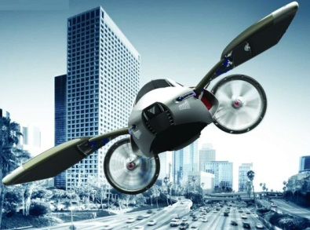
Future Energy
Write 1 page explaining what you would do to address 2 energy needs.
How would you produce electricity for homes and businesses?
How would you produce fuel for transportation?

Slide 18
Future Energy
Your paper has to be neatly written (or typed)
Use complete sentences.
You need to give explanations for your choices. (I want to know how you thought about this)
Due at the end of the hour

Slide 19
Future Energy
Write 1 page explaining what you would do to address 2 energy needs.
How would you produce electricity for homes and businesses?
How would you produce fuel for transportation?

