Slide 1
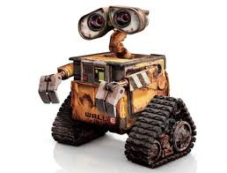
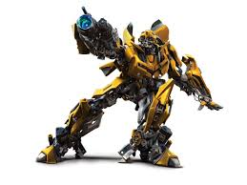
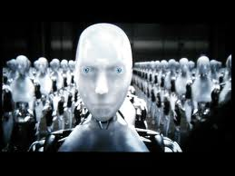
Automation and Robotics * Please pick up your Design and Modeling folder on your way in*
Mr. Jopp
Room C-103
2013-2014

Slide 2
Hr 1
Please go this web address to join our Edmodo group this hour:
https://edmo.do/j/r6q8kx
If you need to register, please enter your isd535 email address.

Slide 3
Hr 4
Please go this web address to join our Edmodo group this hour:
https://edmo.do/j/4qyvqk
If you need to register, please enter your isd535 email address.

Slide 4
Hr 5
Please go this web address to join our Edmodo group this hour:
https://edmo.do/j/2kfyc4
If you need to register, please enter your isd535 email address.

Slide 5
Hr 6
Please go this web address to join our Edmodo group this hour:
https://edmo.do/j/ic78jy
If you need to register, please enter your isd535 email address.

Slide 6
Hr 7
Please go this web address to join our Edmodo group this hour:
https://edmo.do/j/zbrtta
If you need to register, please enter your isd535 email address.

Slide 7
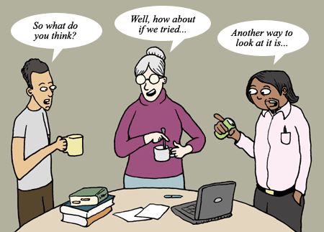
Automation and Robotics vs. Design and Modeling
Things that are the same:
Same classroom
We use computers
Your need Teamwork to be successful
You focus on solving problems

Slide 8
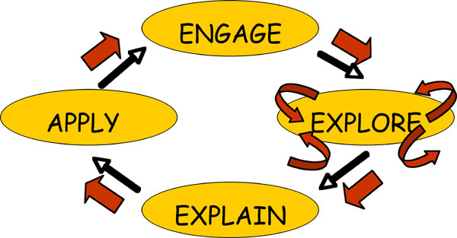
Automation and Robotics vs. Design and Modeling
Things that are the different:
Different mix of students
No Autodesk Inventor
Much more building
Not everyone doing the same thing at the same time

Slide 9
Keep in Mind…
A Simple reminder of Mr. Jopp’s rules:
Be on time
Be respectful
Computers are for school use, not games
Cell phones should stay in your pocket

Slide 10
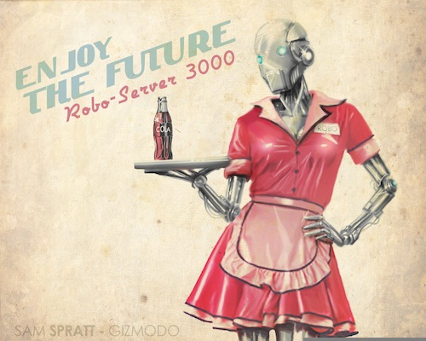
Automation and Robotics
Alright then….what is Automation and Robotics?

Slide 11
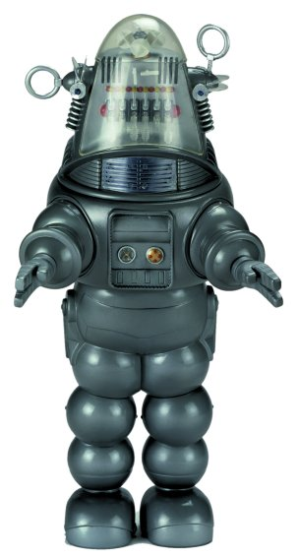
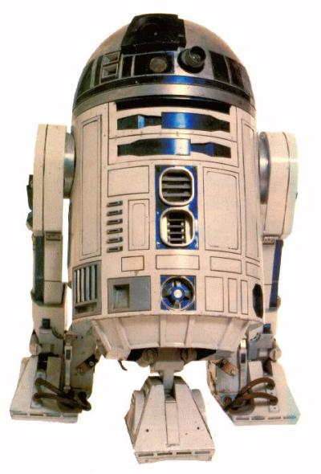
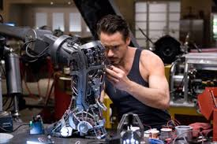
What people think …

Slide 12
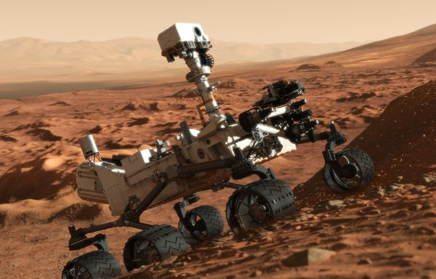
Reality of Robots

Slide 13
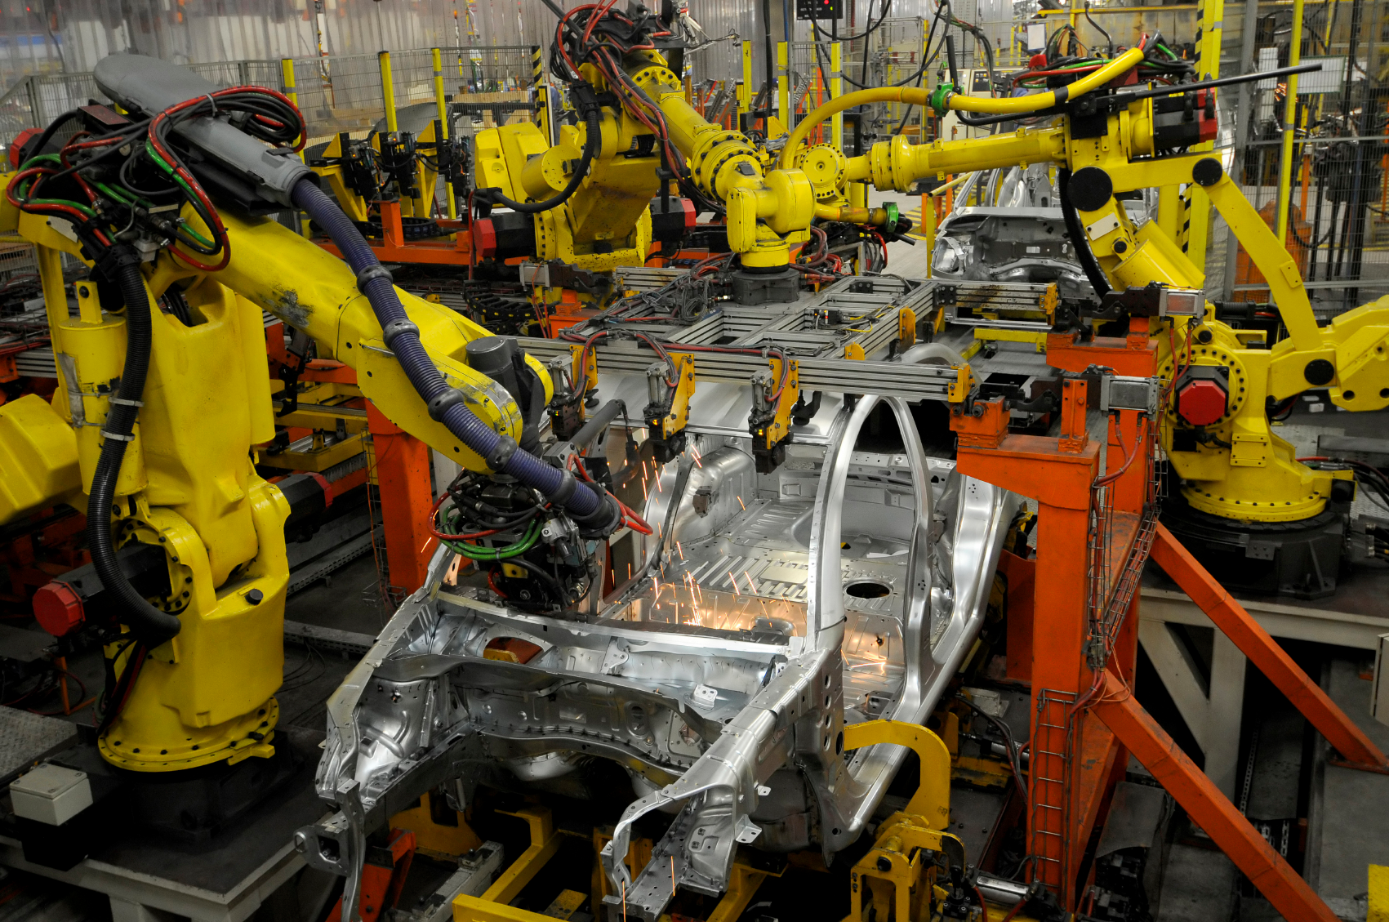
Reality of Robots

Slide 14
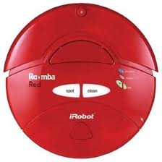
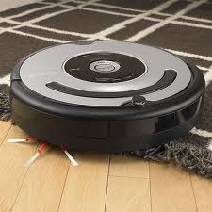
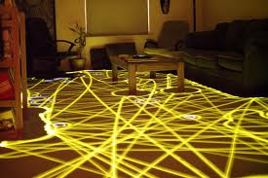
Reality of Robots

Slide 15
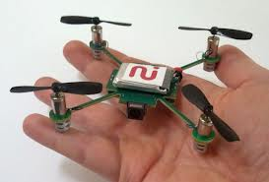
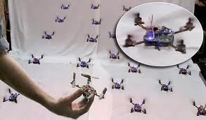
Reality of Robots
WATCH

Slide 16
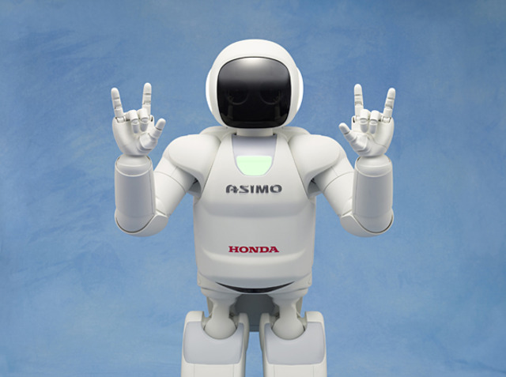
Reality of Robots

Slide 17
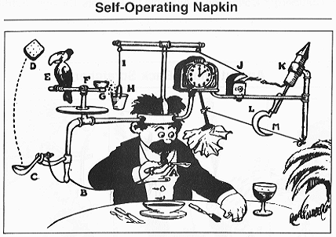
Robot Directions
Robots are only as smart as the directions they are given.
Many simple inputs are needed for a desired output. Even a task that a human finds easy may take hundreds of steps for a robot.

Slide 18
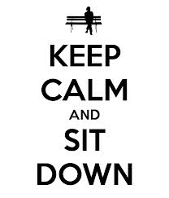
Robot Directions
As you hear the following statements, sit down if they do not apply to you…
You celebrated your birthday this summer
You went to a movie this summer
You ate popcorn at this movie

Slide 19
Robot Directions
Let’s try again, remember, sit down if these do not apply to you…
You went on vacation this summer
You went outside the state of Minnesota
You went swimming this summer
You can’t wait for Vikings football to start because they are the best team in the NFL

Slide 20
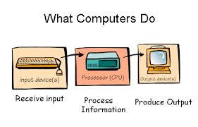
Algorithms
These “Robot Directions “ are called Algorithms. For every set of instructions (inputs) you should have one exact output

Slide 21
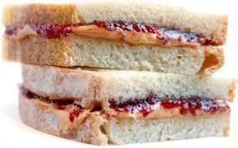
Algorithms
Now you are going to work with a partner of your choice to write the PB&J Algorithm
Write a step-by-step instruction guide to making a PB&J sandwich

Slide 22
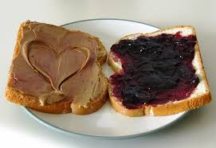
PB&J Algorithm
You will turn these in before the end of the hour
I will select 3 papers tomorrow to follow as I make a PB&J according to your instructions.

Slide 23
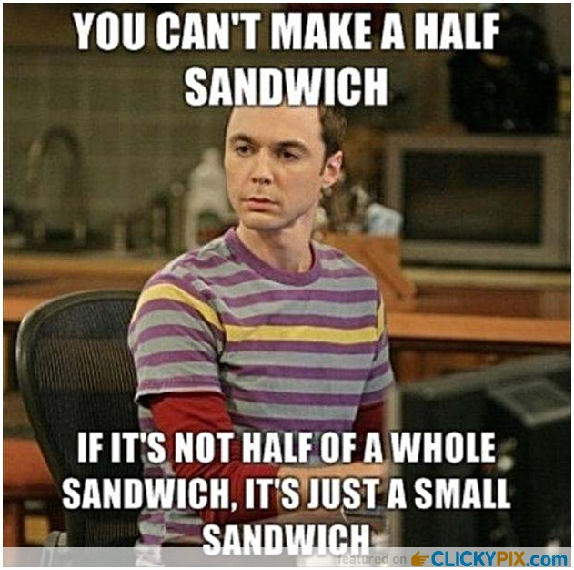
PB&J Algorithm
Your PB&J needs to :
Have 2 slices of bread
Include Peanut Butter & Jelly
Be cut in 4 pieces when finished

