Slide 1
Gear Mechanisms
Multi-Angle Photos to help you build.
Please open your packet to page 1

Slide 2
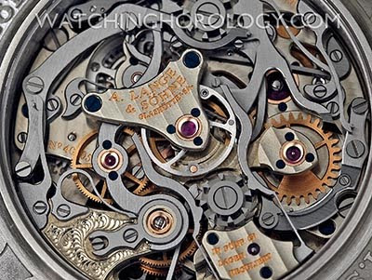
Monday Definitions…
Mechanism – A system of parts working together.

Slide 3
Monday Definitions…
Gear – A rotating machine part with teeth

Slide 4
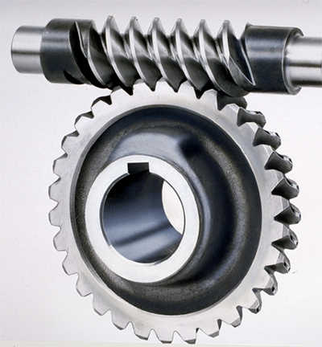
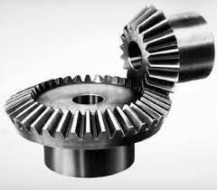
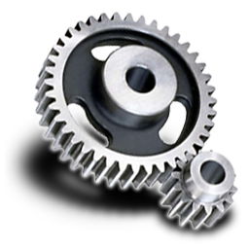
Monday Definitions…
Gear Train – 2 or more gears connected together to do work.

Slide 5
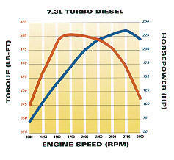
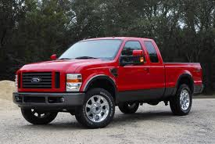
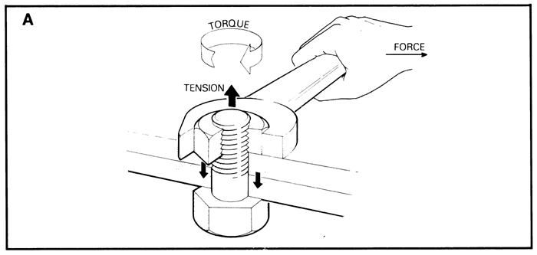
Monday Definitions…
Torque – Force applied to turn an object

Slide 6
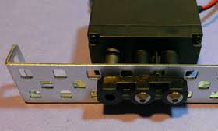
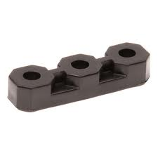
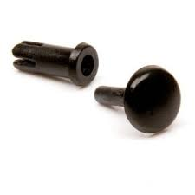
Before you start…
Three tips to a successful building experience.
Never force any parts together, or over-tighten them. Gentleness is the key!
Make sure you have the right screwdriver. Shiny screws need the screwdriver with the shiny end.
Always use plastic ‘bearings’ when using a metal rod or “axle”. This allows it to move more freely.

Slide 7
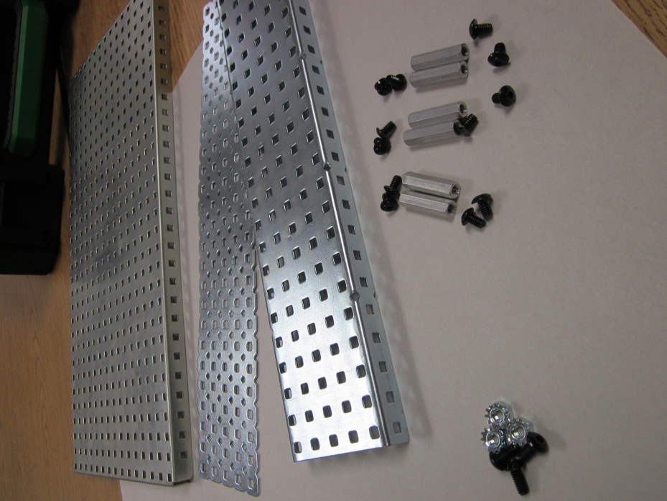
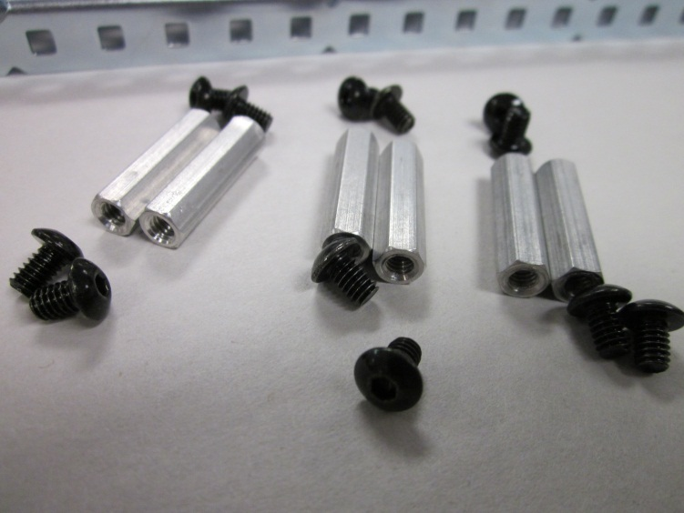
Gear Base
Parts needed

Slide 8
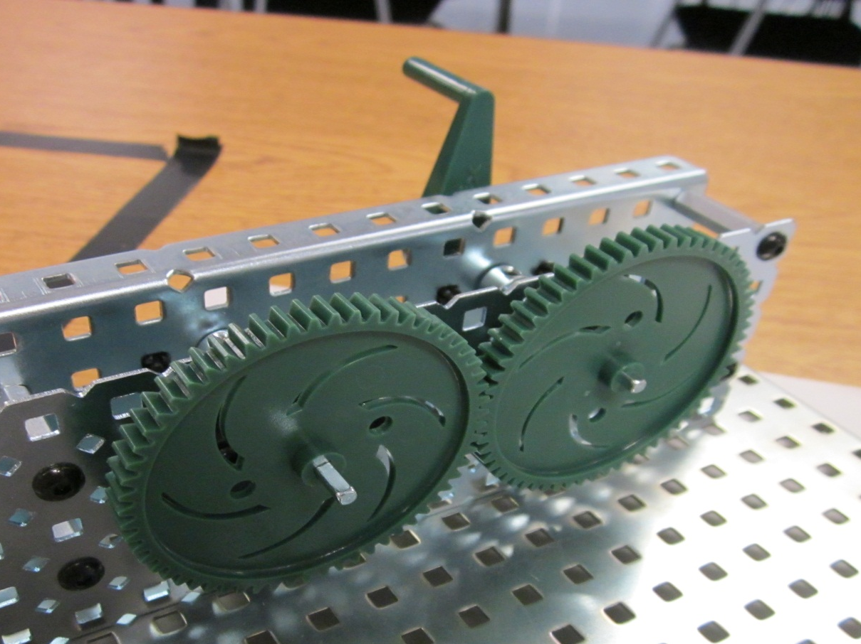
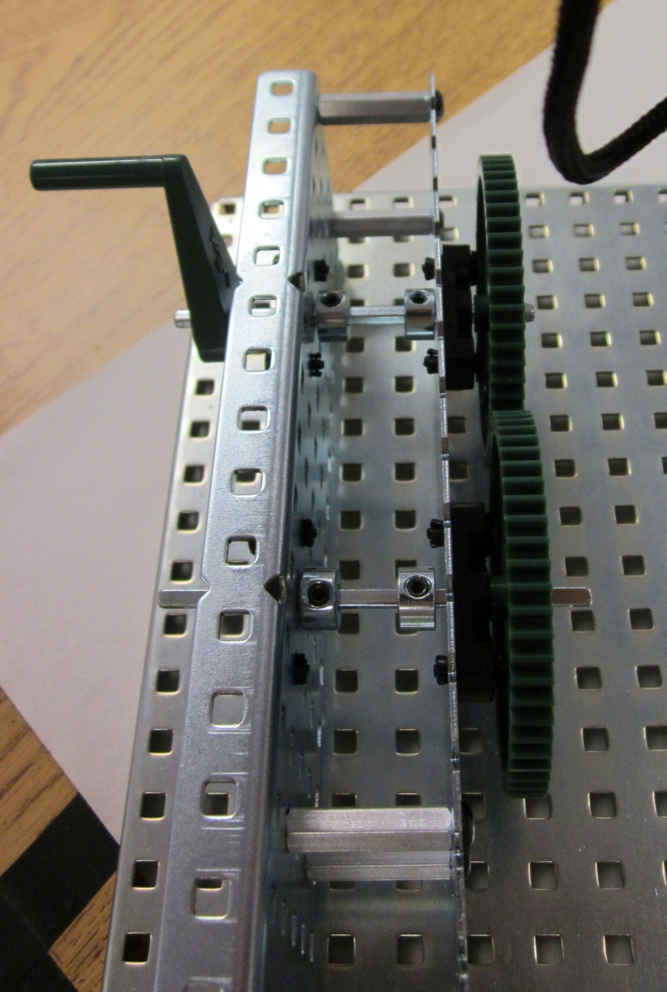
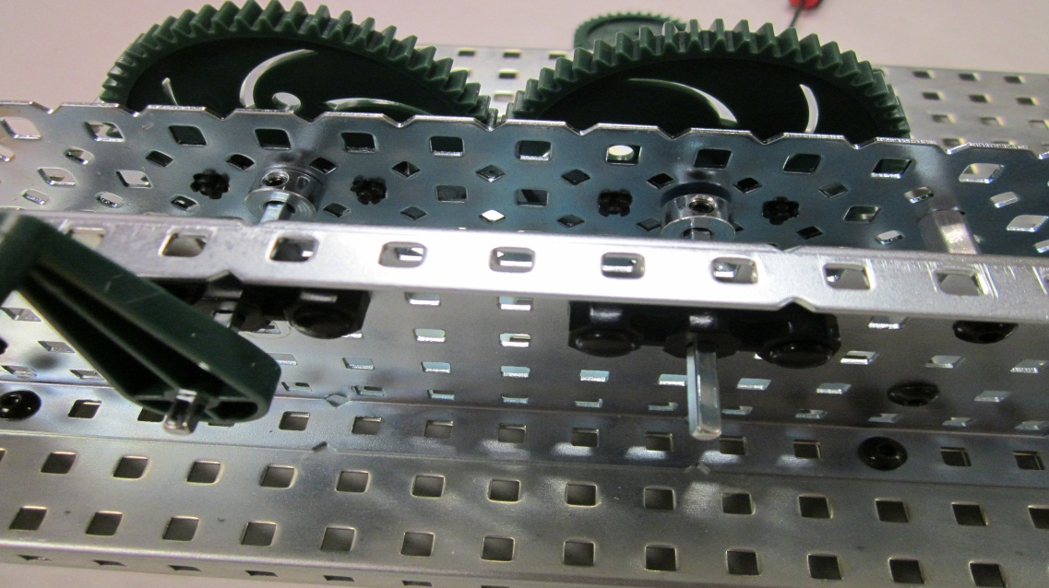
Simple Gear Train
FRONT
TOP
BACK

Slide 9
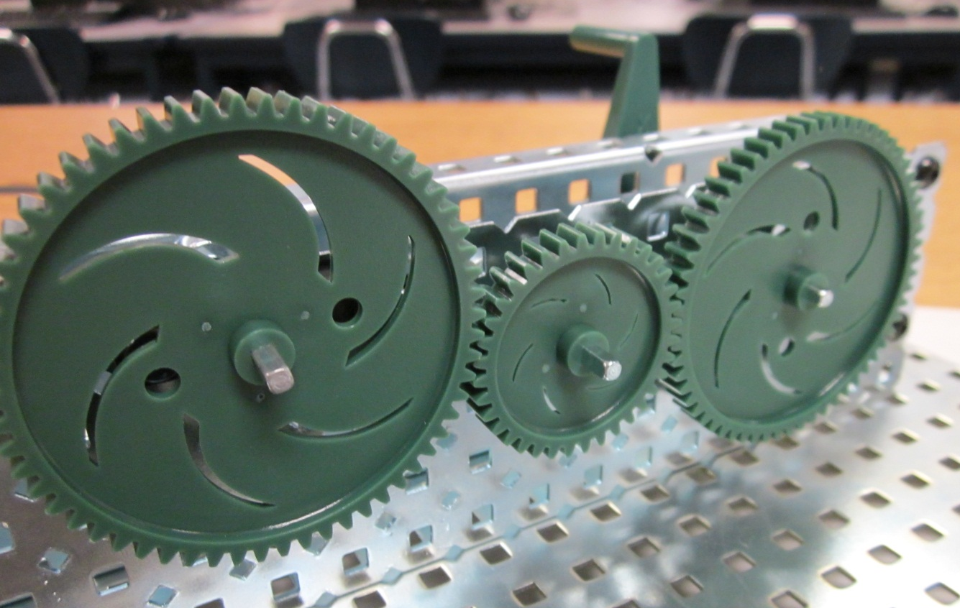
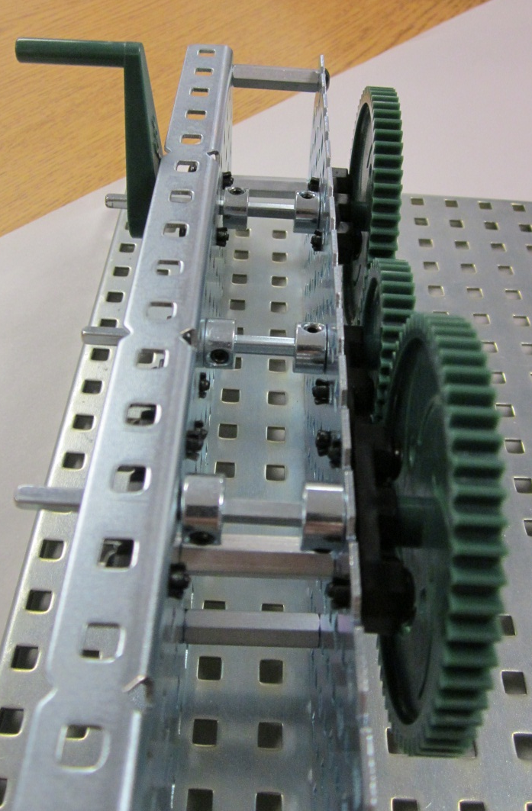
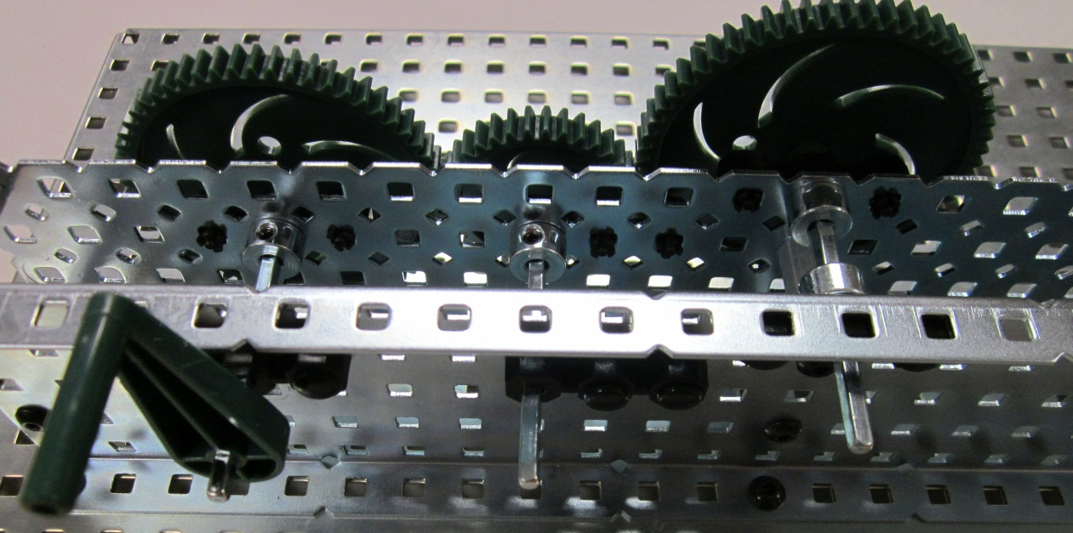
Gear Train with Idler
FRONT
TOP
BACK

Slide 10
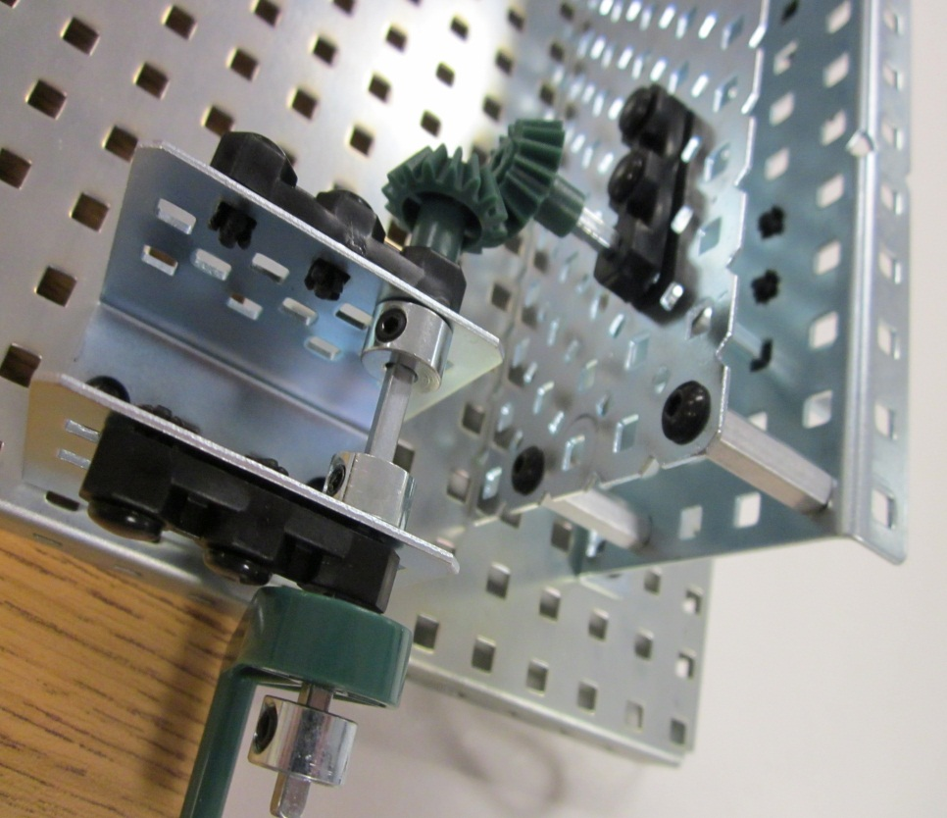
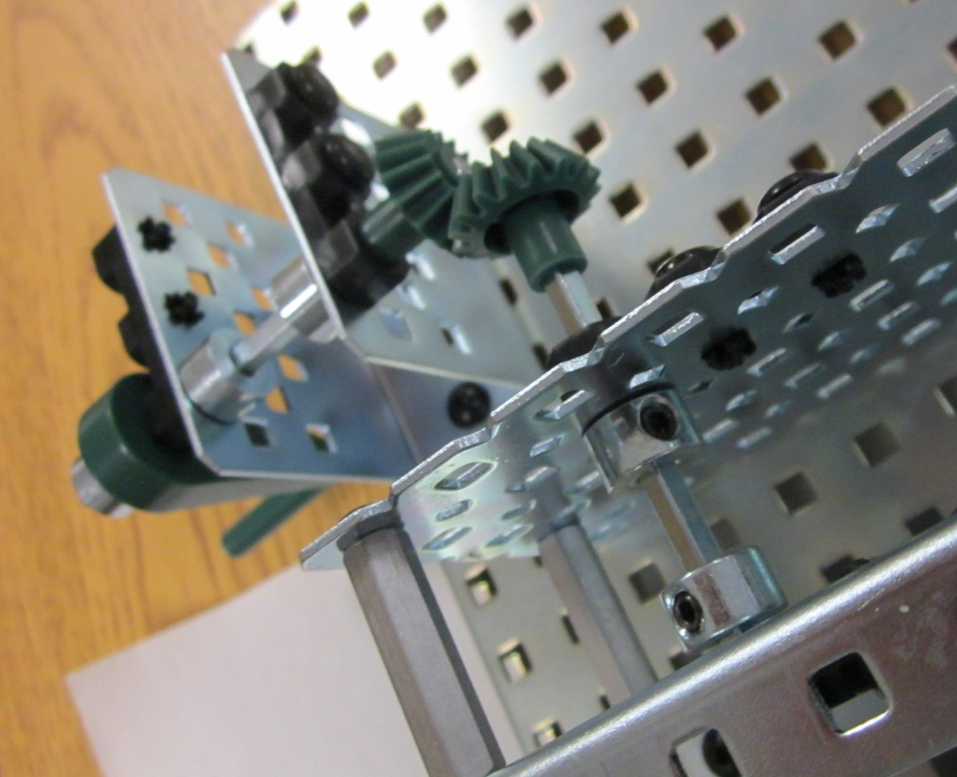
Bevel Gear
FRONT
SIDE
BACK

Slide 11
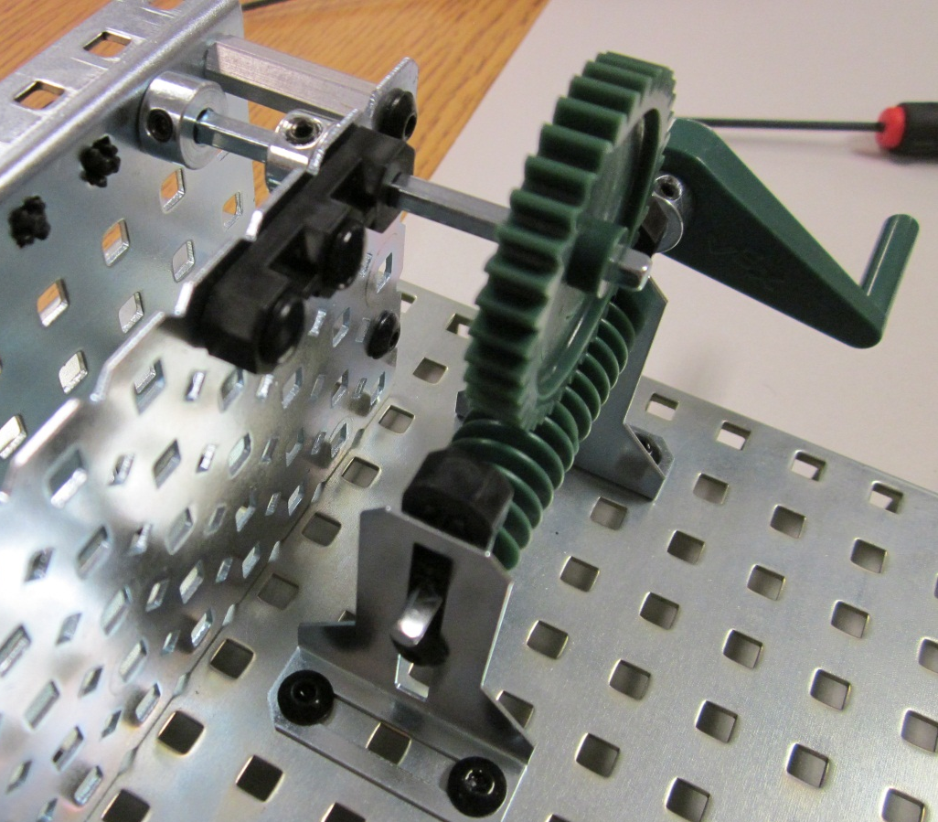
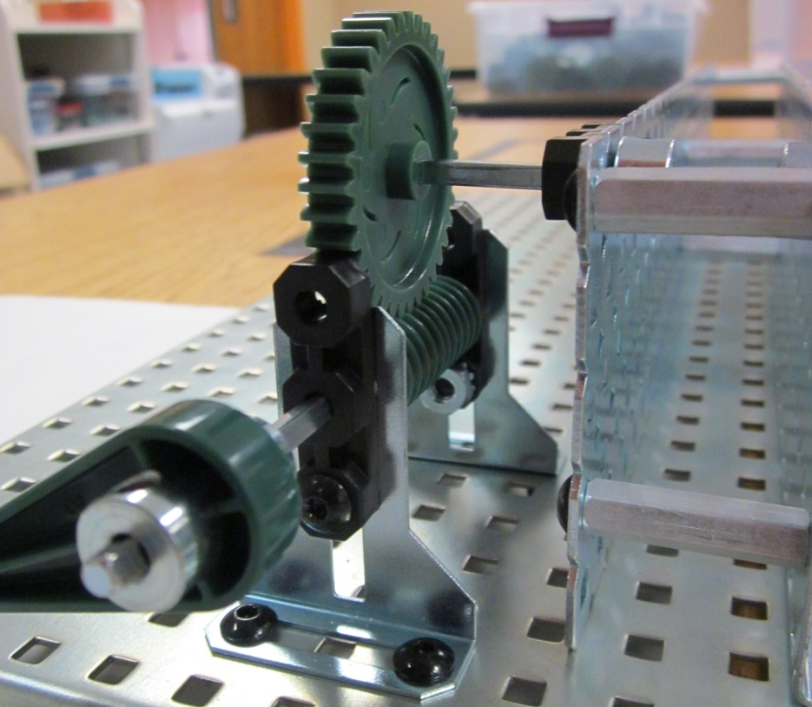
Worm and Wheel
FRONT
SIDE
TOP

Slide 12
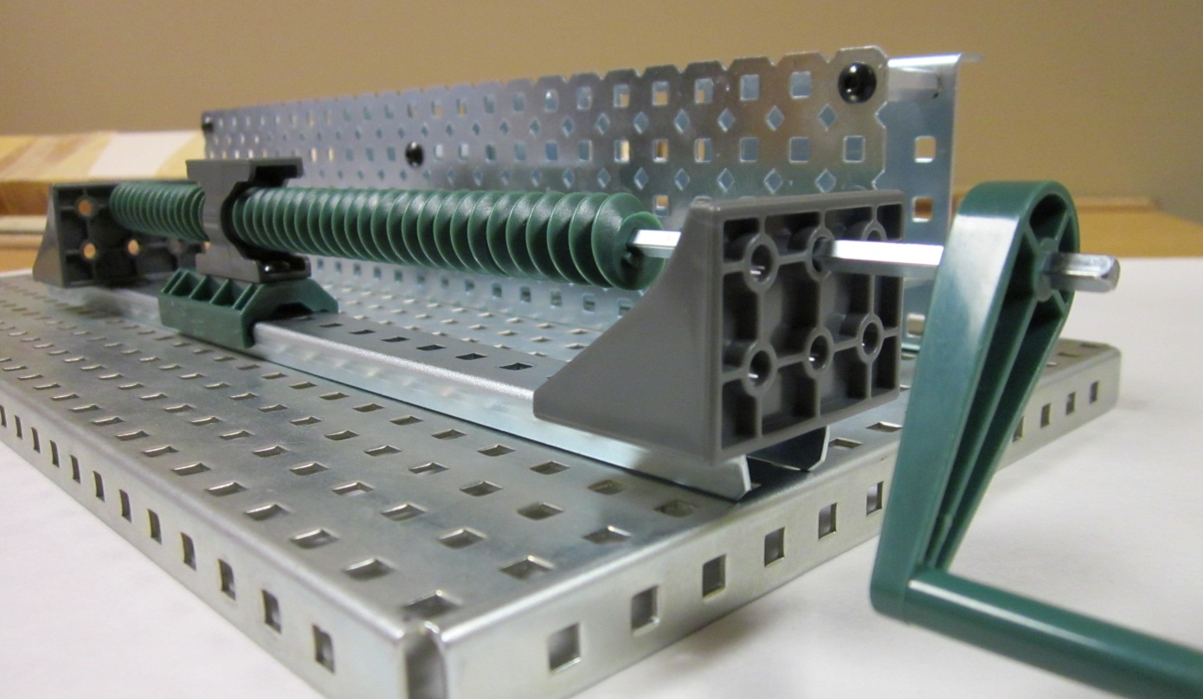
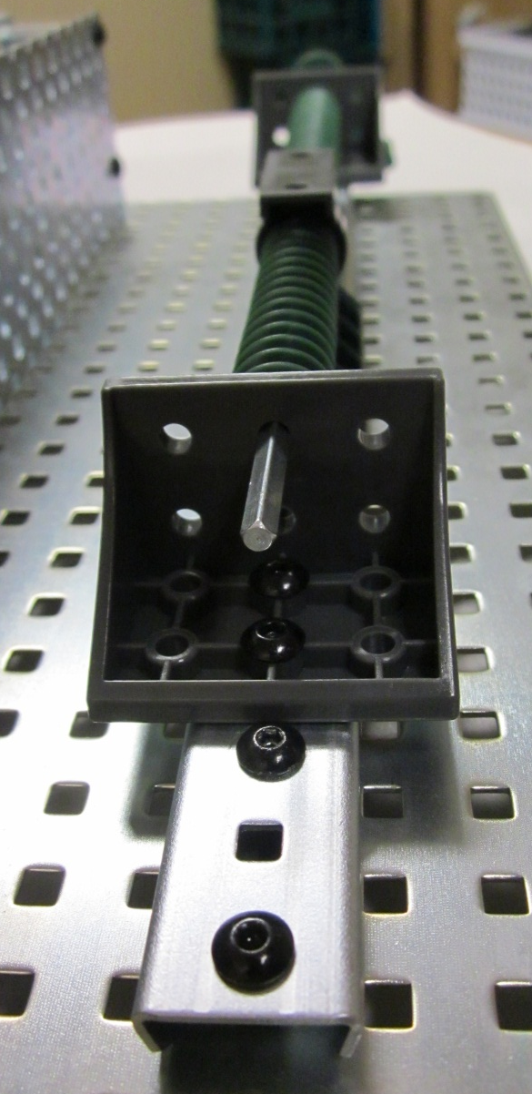
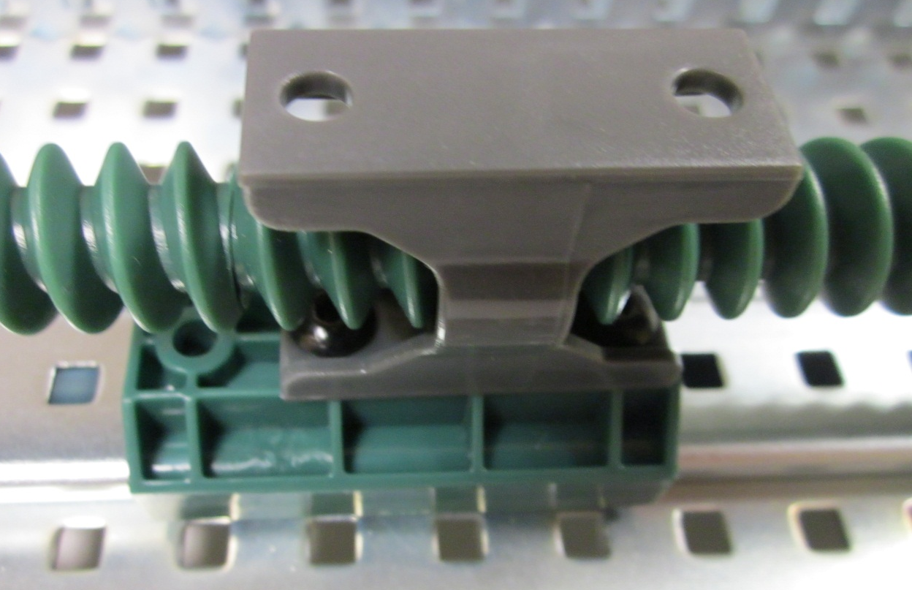
Leadscrew
FRONT
MIDDLE ASSEMBLY
END

Slide 13
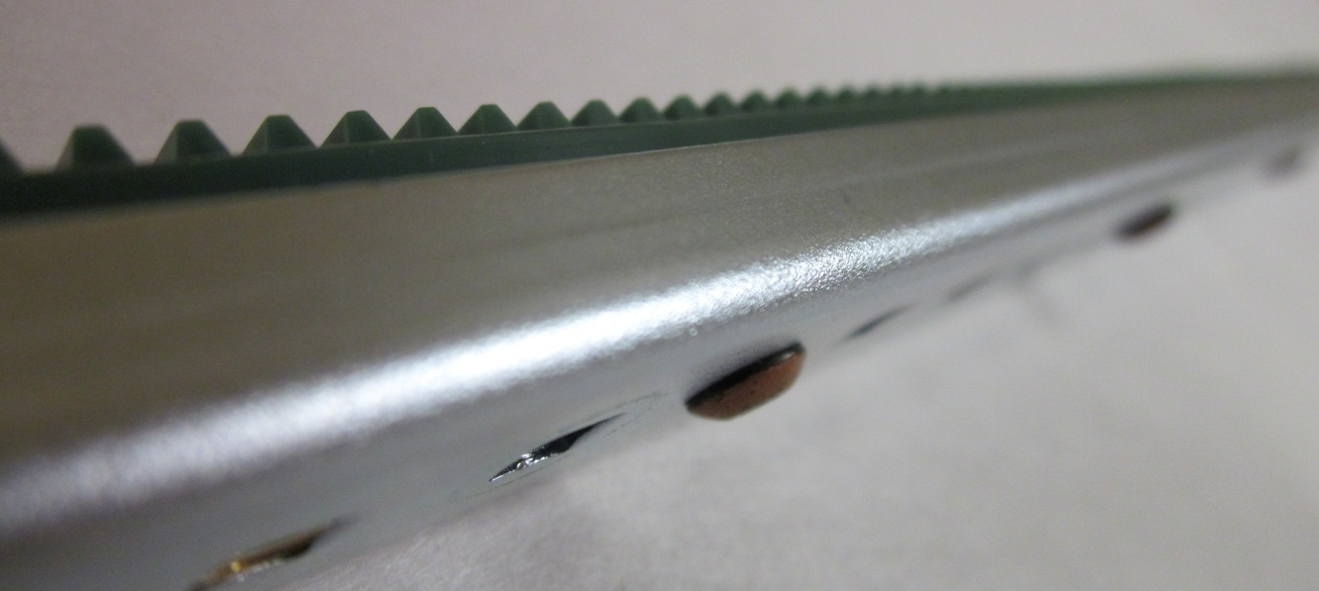
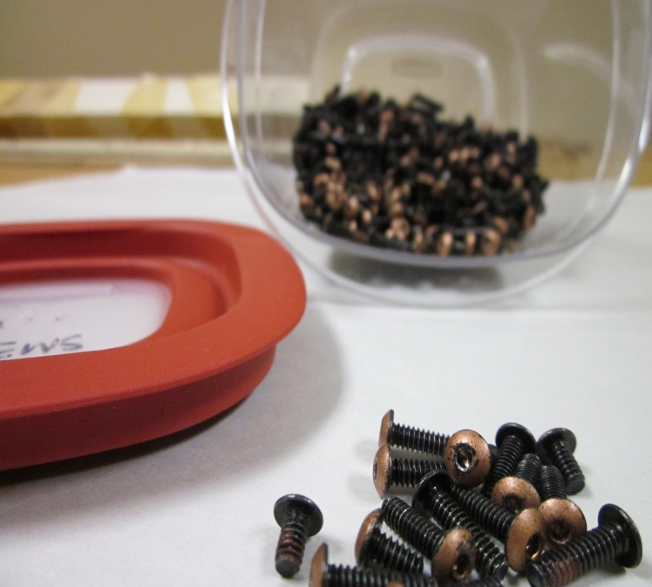
Rack and Pinion Part1
RACK WITH MOTOR SCREWS
MOTOR SCREWS
SLIDER ASSEMBLY

Slide 14
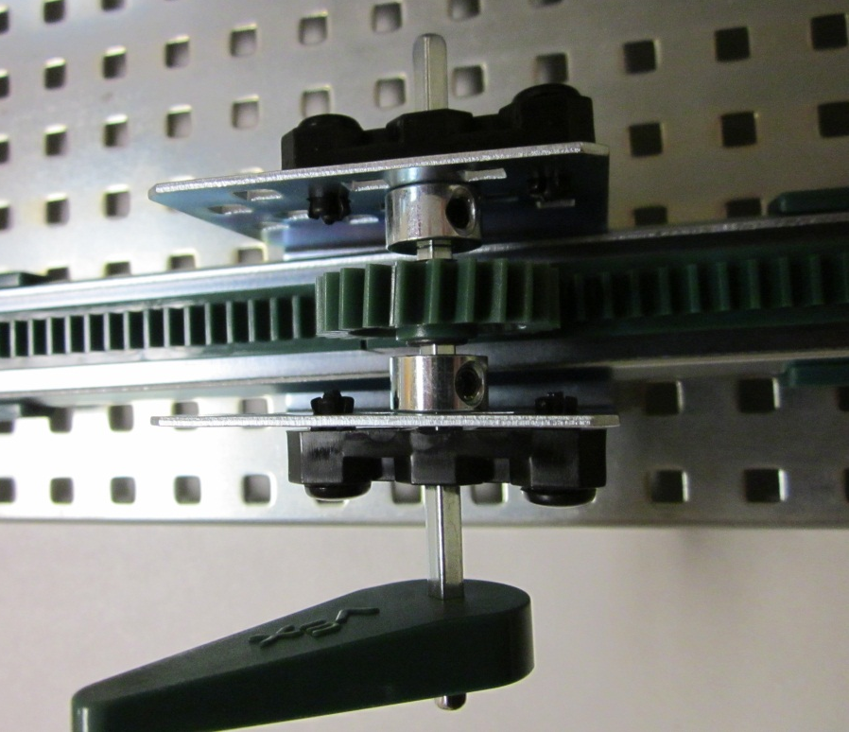
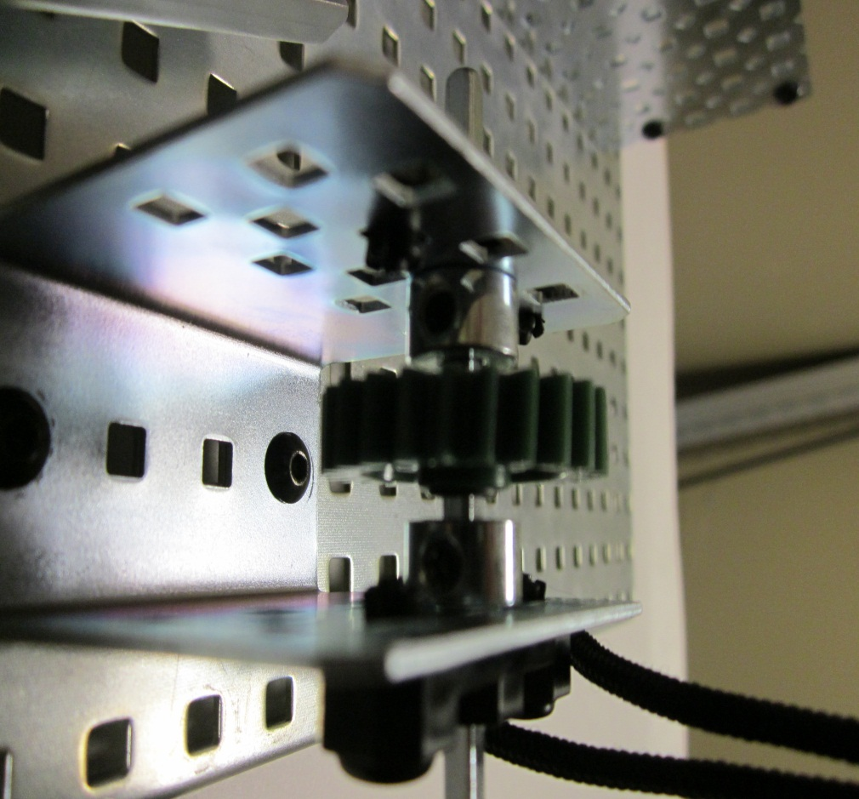
Rack and Pinion Part2
SIDE
TOP
PINION GEAR

Slide 15
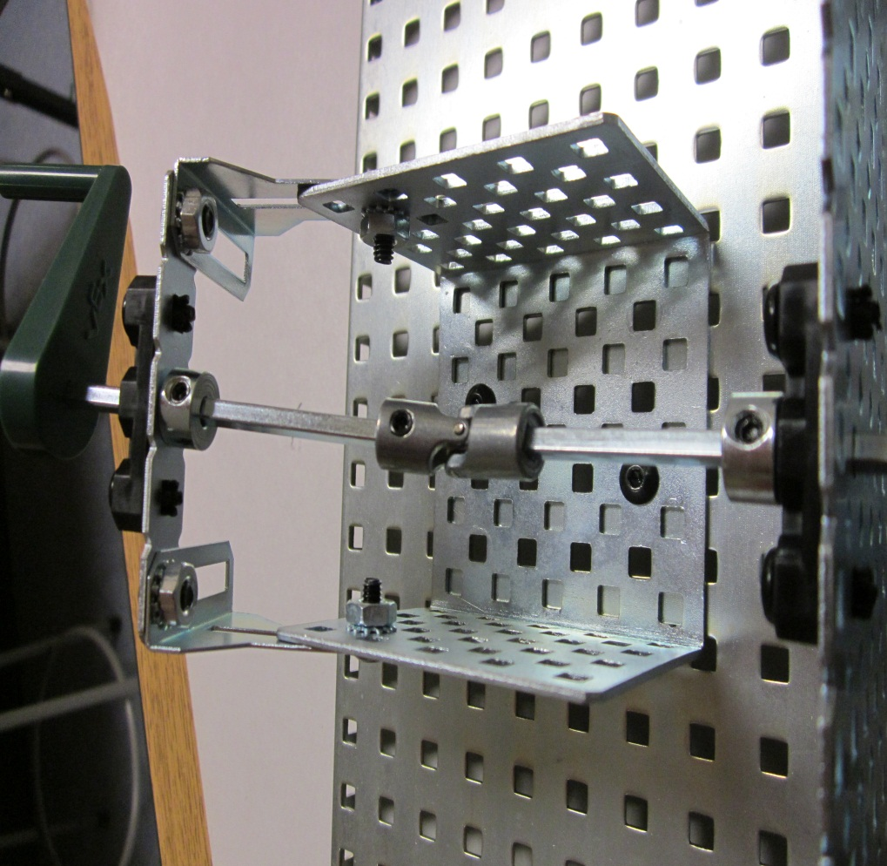
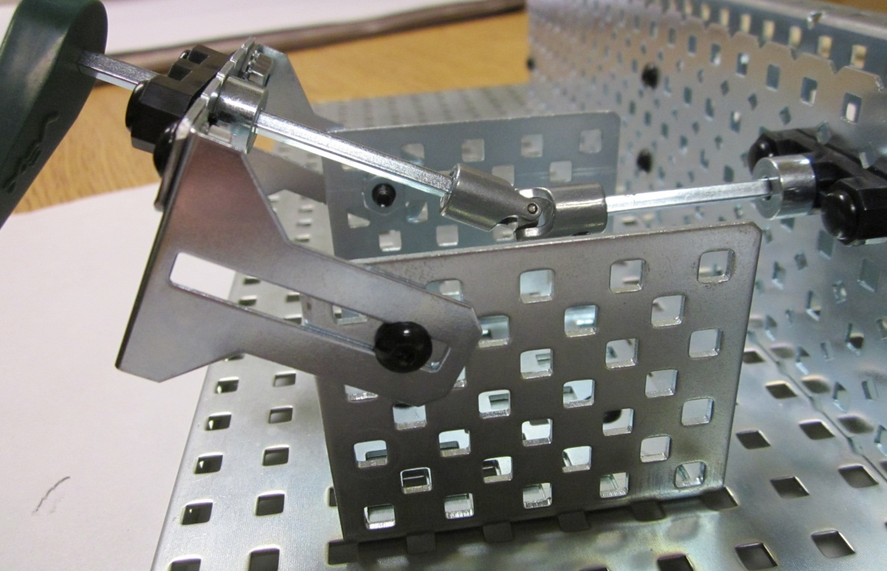
Universal Joint
FRONT
TOP
SIDE

Slide 16
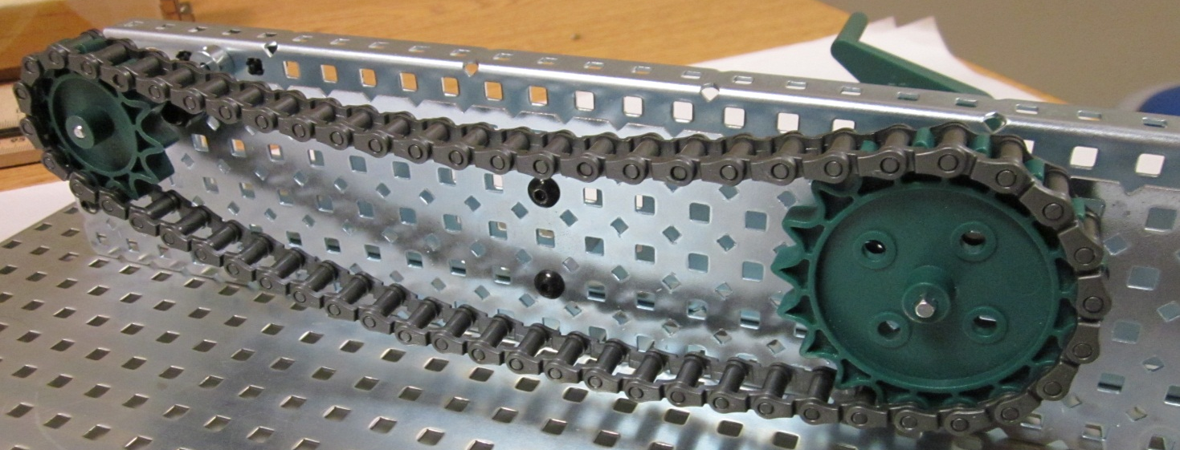
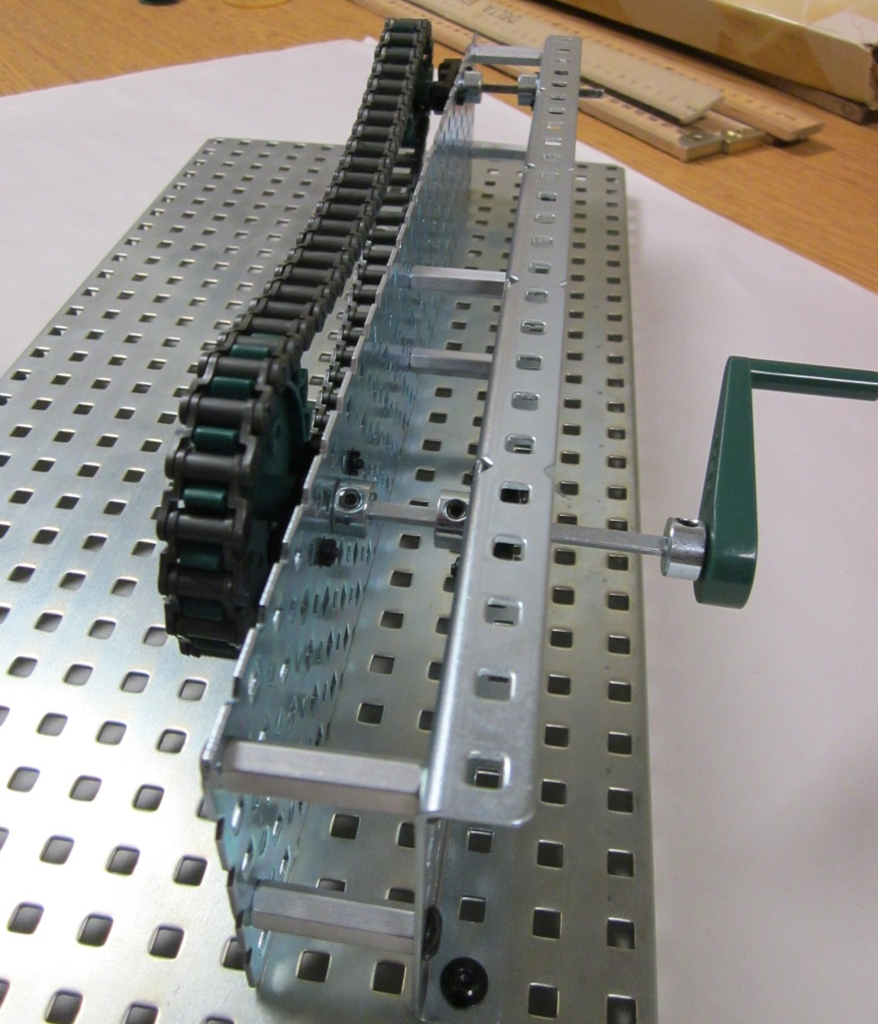
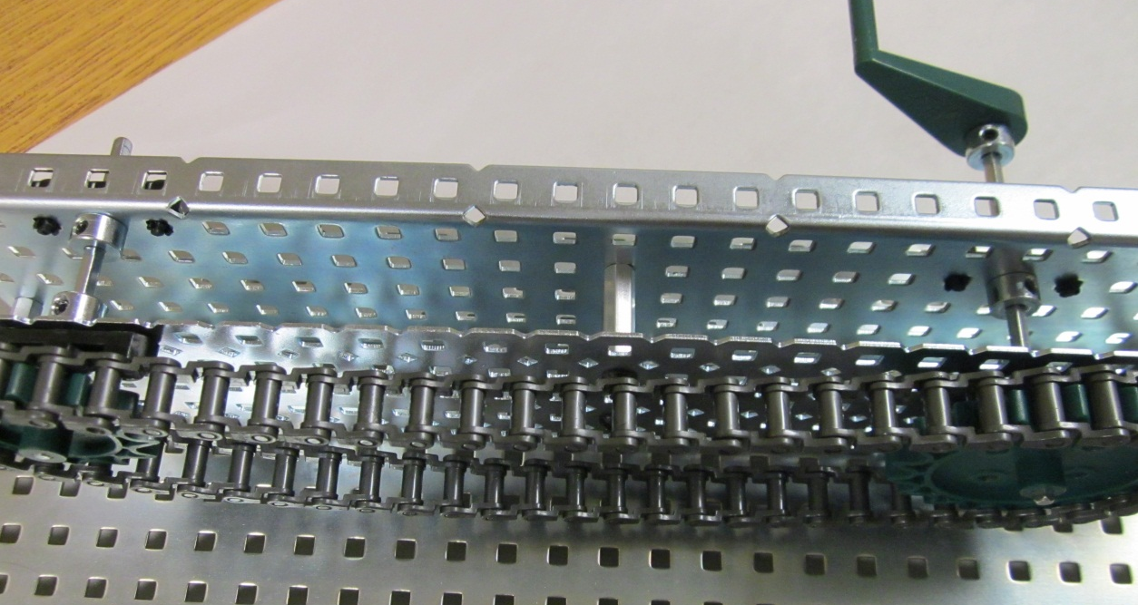
Chain Drive
FRONT
SIDE
TOP

Slide 17
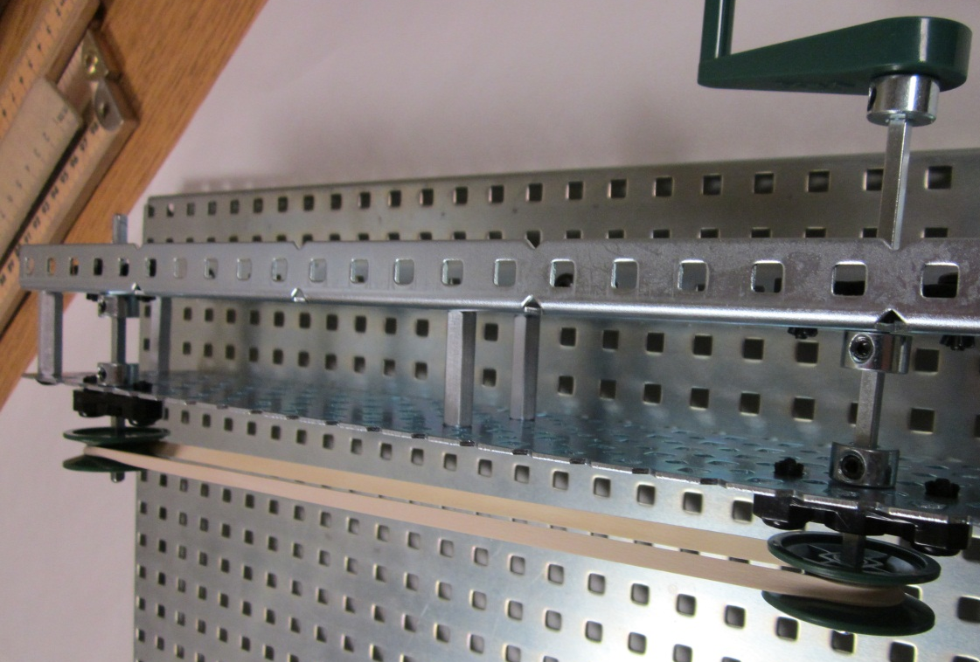
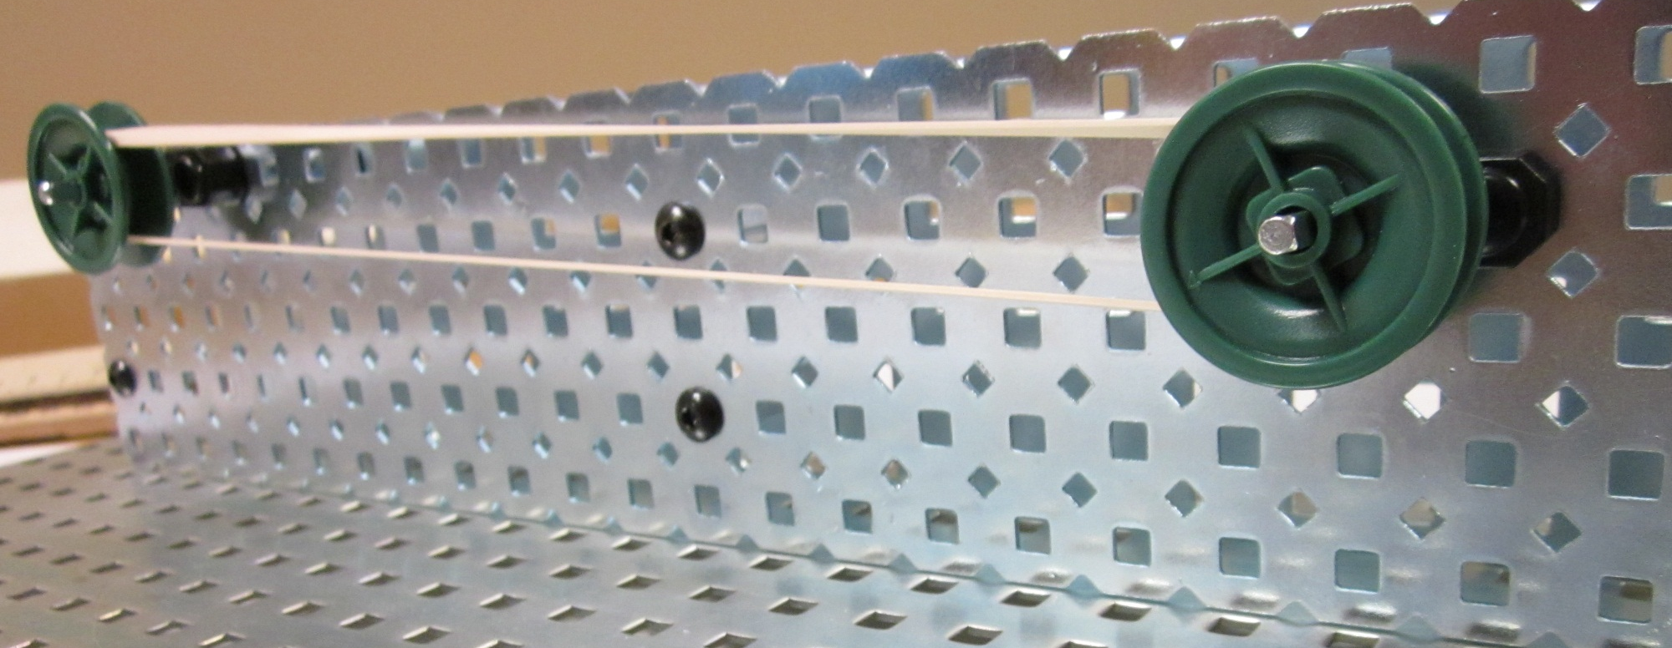
Belt Drive
TOP
FRONT

Slide 18
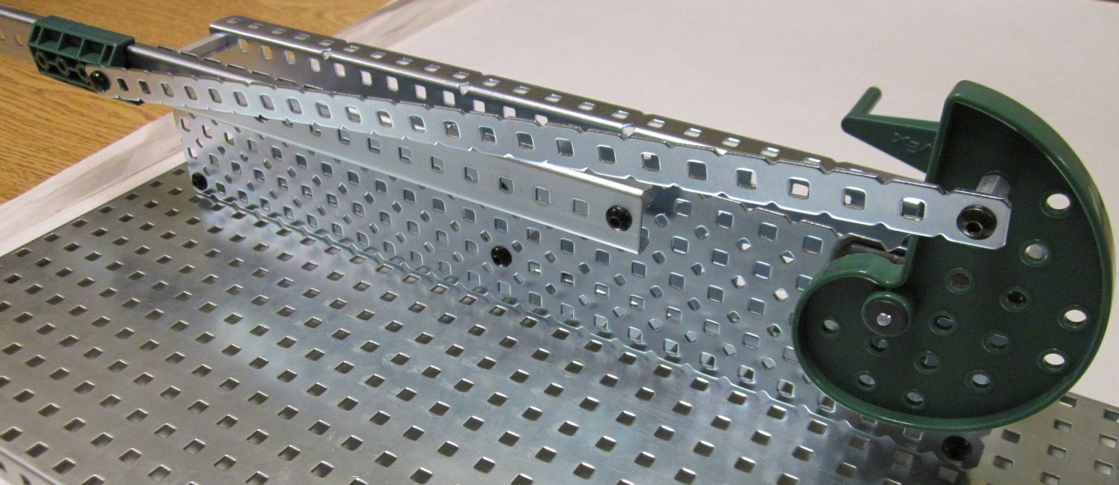
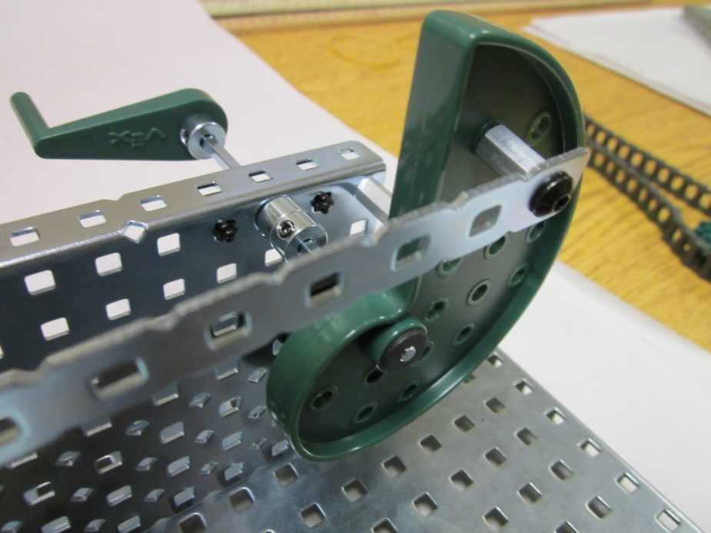
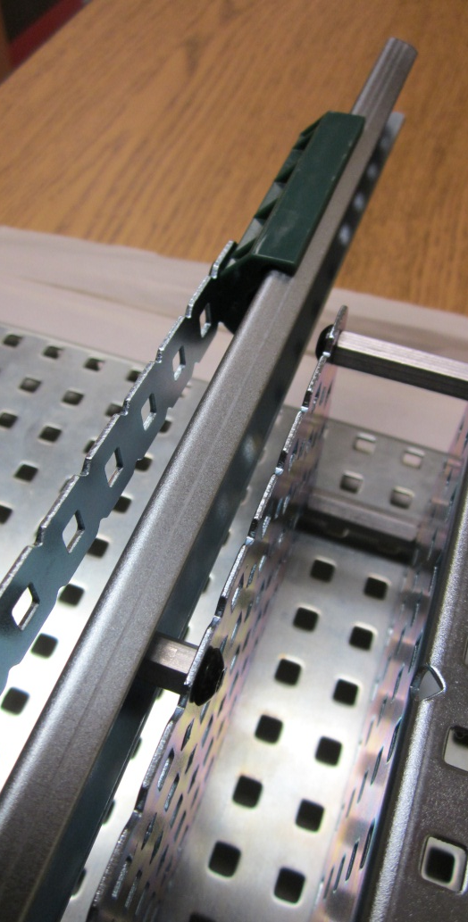
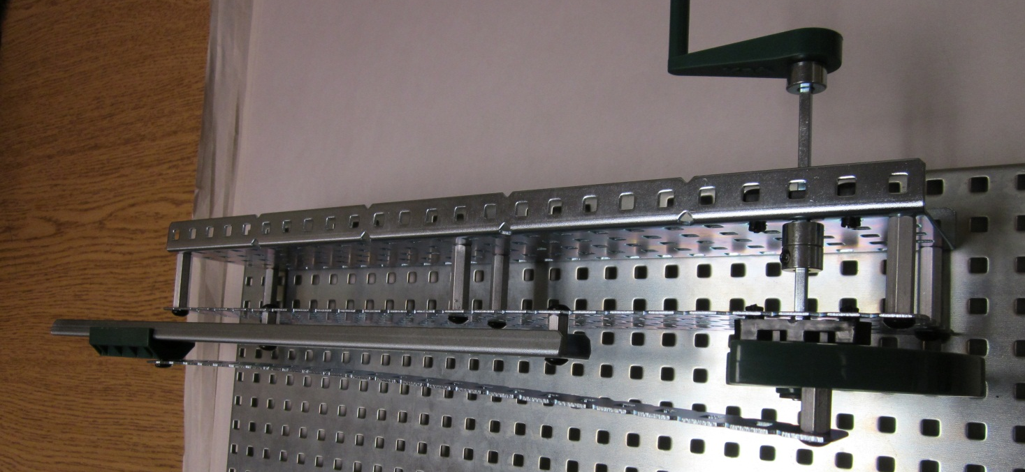
Crank and Slider
FRONT
CRANK
TOP
SLIDER

Slide 19
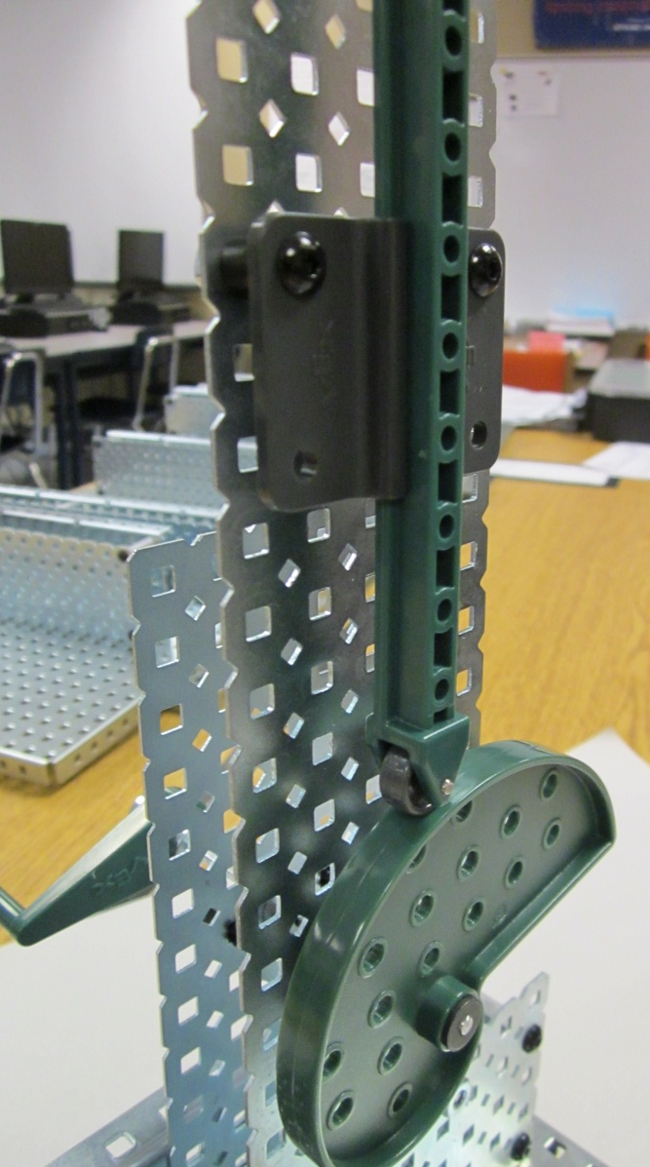
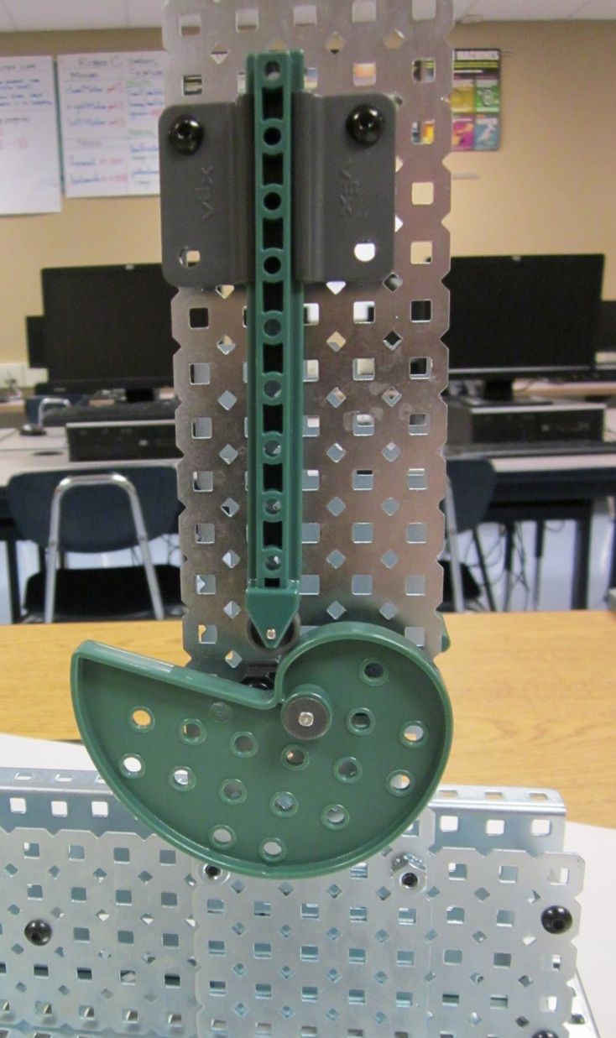
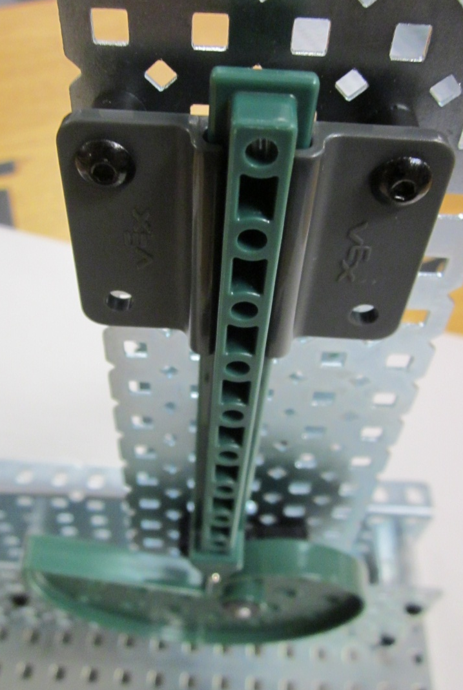
Cam and Follower
TOP
SIDE
FRONT

Slide 21
What to Build…
Use the building guide or the photos on Edmodo to build the gear mechanisms.

