Slide 1
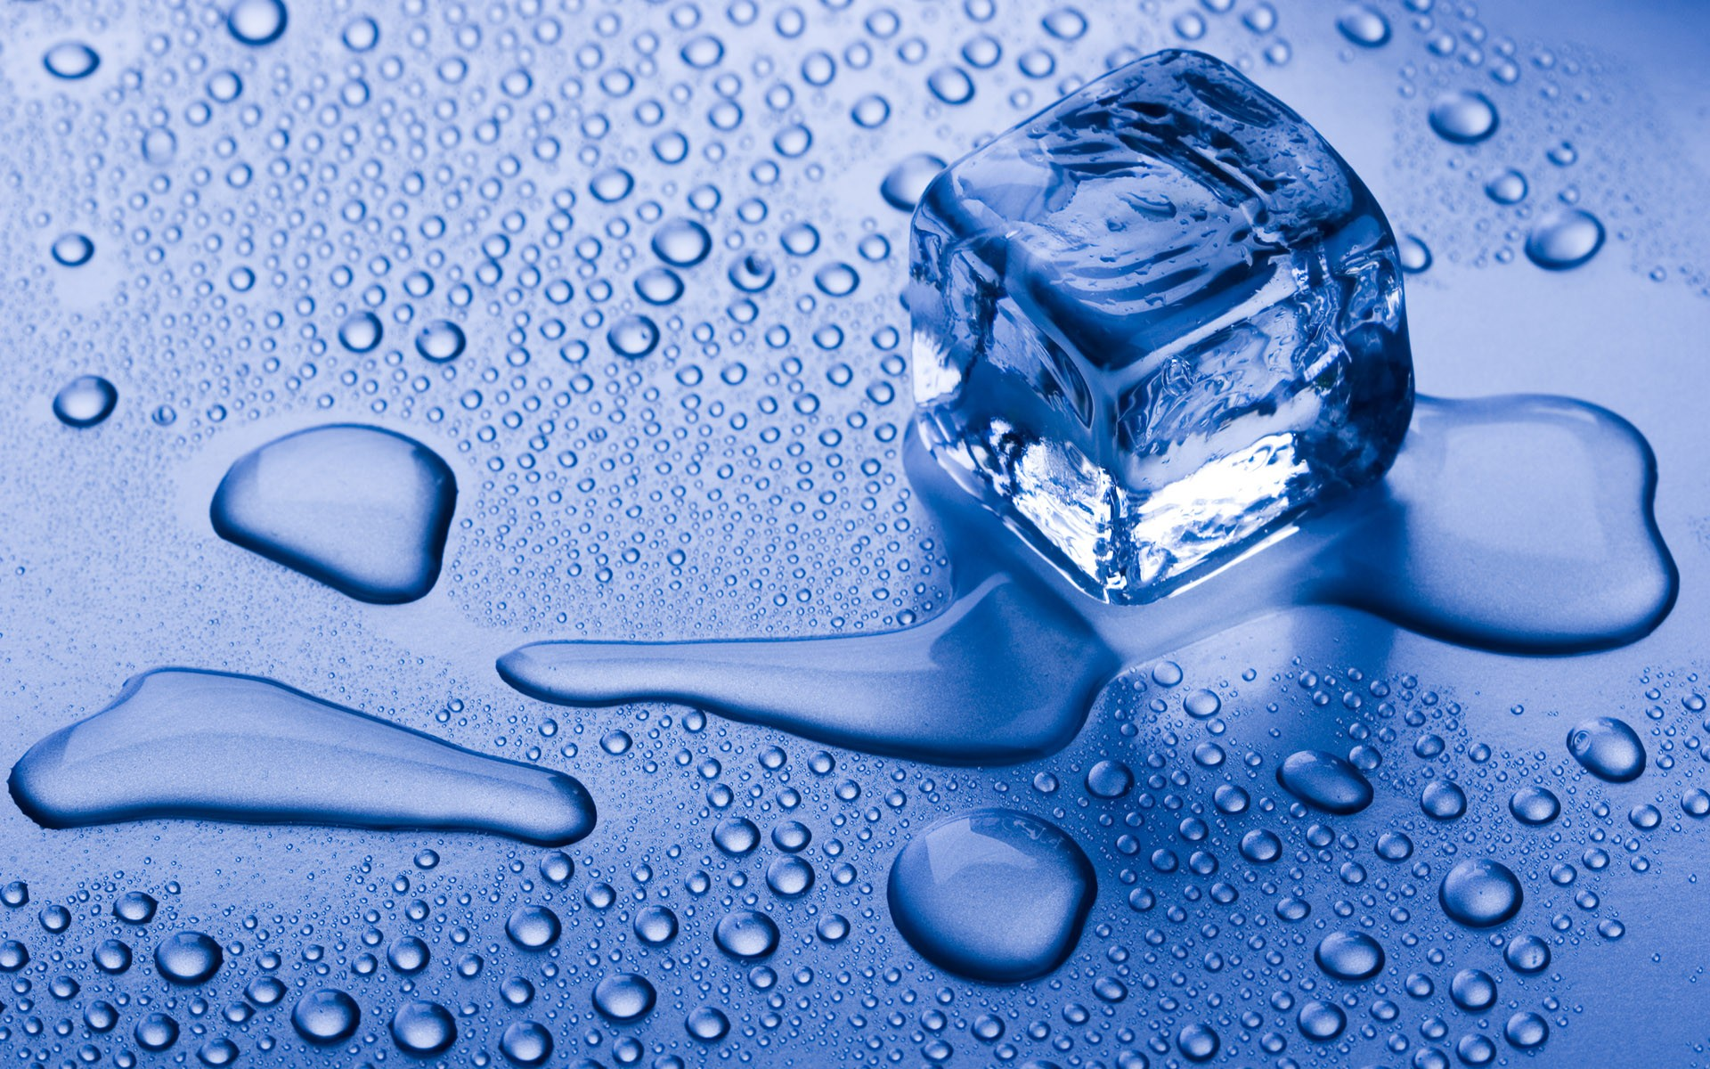
Heat Transfer…
What’s more fun than melting ice?

Slide 2
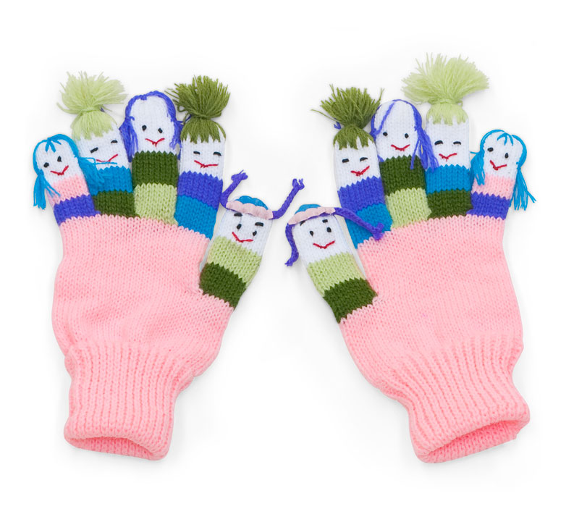
Some questions to start…
Please write these on a sheet of paper.
How does wearing a black shirt on a hot day feel different from wearing a white shirt on a hot day?
Why?
How do gloves keep your hands warm in winter?

Slide 3
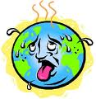
Last Question
Do different materials work better than others when keeping your hands warm?
The idea that heat moves from warm to cold is called “Heat Transfer”
Certain materials speed up or slow down this process

Slide 4
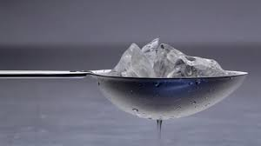
A couple of demonstrations…
I will put an ice cube on a metal spoon and on a plastic spoon. Which will melt faster?
Why?

Slide 5
Insulated sodas
Please copy the following chart on your paper
Insulator | Temp at beginning | Temp at 10 min
Aluminum Foil | 59 | 59
Paper Towel | 60 | 64
Cotton Glove | 63 | 64.4
Wool Glove | 64 | 59

Slide 6
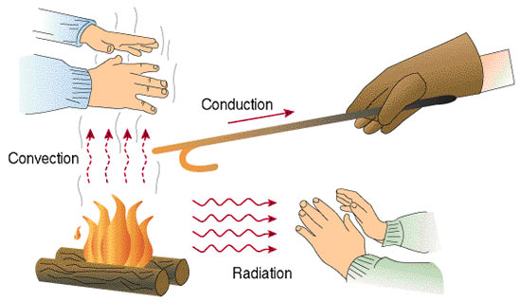
Heat Transfer

Slide 7
Insulated sodas
Please copy the following chart on your paper
Insulator | Temp at beginning | Temp at 10 min
Aluminum Foil
Paper Towel
Cotton Glove
Wool Glove

