Slide 1
Intro to Robotics and Energy
Monday, Sept 23rd
Skyward
2. Calendar
3. Intro to Robotics & Energy

Slide 2
Skyward
Please check Skyward to make sure the first 2 grades are correct. I will hand back your quizzes from last week as you check your grades. The quiz grade will be added on Thursday.
A make-up quiz will be available Thursday during class as well.

Slide 3
Calendar
Over the next 3 weeks, hours 1,3, & 4 will be continuing with Robotics programming.
Hours 5,6, & 7 will begin a 3 week unit on Energy and the Environment.
After 3 weeks, the units will be switched for the morning and afternoon sections.

Slide 4
Calendar
We have to do this because of limited equipment and to avoid having to take our creations apart at the end of every hour.
Everyone will get to do the same thing, just at different times

Slide 5
Energy and the Environment
How do we get the energy needed to run an automated world?

Slide 6
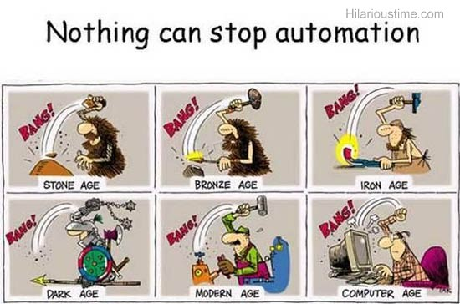
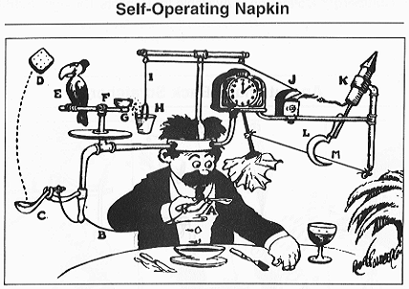
Programming
How can we automate tasks for humans?

Slide 7
Energy and the Environment
Today, I would like you to work in your groups to create some art. It must have color!
Divide a large piece of paper into 3 sections.
In one section write the word “ENERGY” and find pictures or draw pictures to show as many types of energy as you can think of.
In a second section write the word “CONSERVE” and find pictures or draw pictures to show all the ways to conserve that you can think of
In the third section write the word “RECYCLE” and find pictures or draw pictures to show all of the ways you can think of to recycle materials or objects.

Slide 8
Programming
How can we automate tasks for humans?
First, Let’s start with this Programmer and Machine summary.
Writing Robot Behaviors – “Pseudocode”

Slide 9
Robot Behaviors
Basic Behaviors
Simple Behaviors
Complex Behaviors

Slide 10
Robot Behaviors
Basic Behaviors
Simple Behaviors
Complex Behaviors: The task you want the robot to complete.

Slide 11
Robot Behaviors
Basic Behaviors
Complex Behaviors
Simple Behaviors: Step-by-step directions of what needs to be done. Also called “Pseudocode”

Slide 12
Robot Behaviors
Simple Behaviors
Complex Behaviors
Basic Behaviors: Instructions that a robot can understand and follow

Slide 13
Robot Behaviors
The difference between Pseudocode (Simple behavior) and Basic behavior (programming code) is that Pseudocode does not have to include motor, sensor, or speed instructions.
Pseudocode is written in your own words. Programming code is written using specific language.

Slide 14
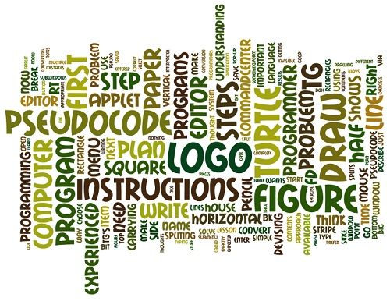
Writing Pseudocode
Work with your group to complete activity 2.3.2
Read the examples given and complete the questions. We will discuss them tomorrow at the beginning of class.

