Slide 1
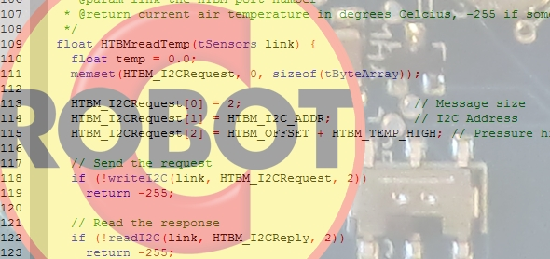
Sensors and Robot C
Add switches to your code

Slide 2
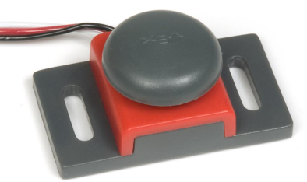
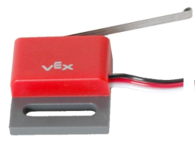
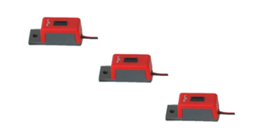
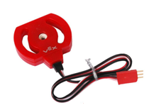
Sensors
2. Attach Sensors to the model and Cortex
4 Sensors:
Touch /
Bumper Switch
Limit Switch
Line Tracker
Potentiometer
Notes:
Sensors are used so the robot can sense its environment, and the robot can adjust its own behaviors based on that knowledge. A sensor will generally tell the robot about one very simple thing in the environment, and the robot’s program will interpret that information to determine how it should react. The Bumper Switch sensor, for instance, will tell the robot whether it is in contact with a physical object or not. Depending on how the sensor is set up, this can tell the robot a lot of different things. If the sensor is mounted on the front bumper, the robot could use this information to tell whether it has run into an obstacle, like a wall inside a maze.
By making good use of sensors to detect the important aspects of its environment, a robot can make things much easier for its human operator. A robot can even operate completely independent of human control, autonomously.

Slide 3
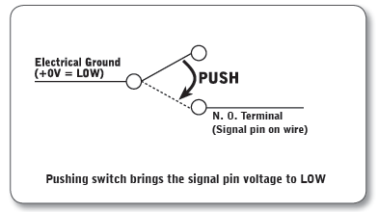
Limit Switch Sensor
Signal: Digital
Sensor Values: 1 = pressed, 0 = released
Description: The limit switch sensor is a physical switch. It can tell the robot whether the sensor’s metal arm is being pushed in or not.
Type: SPDT microswitch, configured for SPST Normally Open behavior.
Signal Behavior:
Notes:
Signal Behavior: When the switch is not being pushed in, the sensor maintains a digital HIGH signal on its sensor port. This High signal is coming from the Microcontroller. When an external force (like a collision or being pressed up against a wall) pushes the switch in, it changes its signal to a digital LOW until the switch is released. An unpressed switch is indistinguishable from an open port.

Slide 4
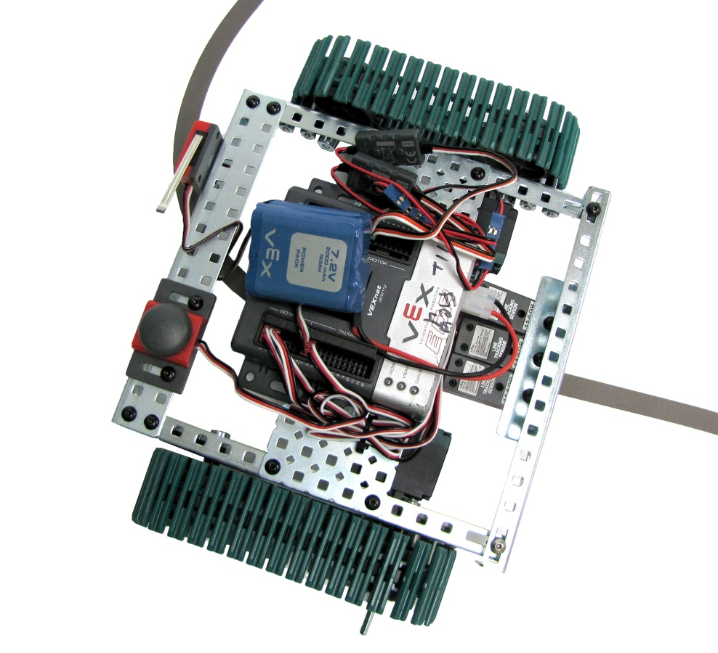
Line Tracker
Signal: Analog
Sensor Values: Range from 0-4095
Description: A line follower consists of an infrared light sensor and an infrared LED. It works by illuminating a surface with infrared light; the sensor then picks up the reflected radiation and, based on its intensity, determines the reflectivity of the surface. Light colored surfaces will reflect more light than dark surfaces. This allows the sensor to detect a dark line on a pale surface, or a pale line on a dark surface.

Slide 5
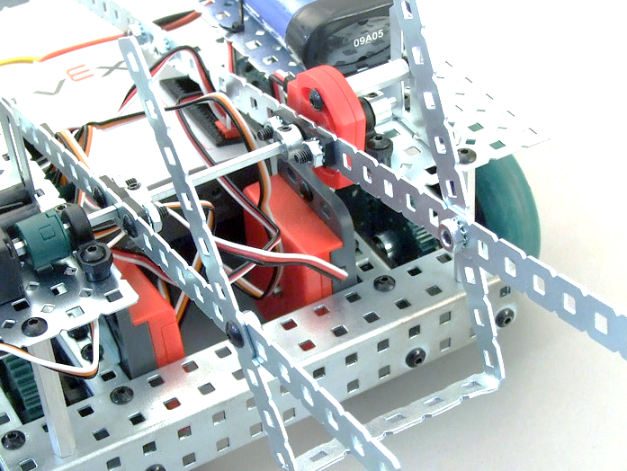
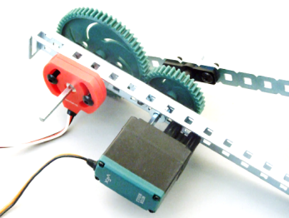
Potentiometer
Signal: Analog
Sensor Values: Range from 0-4095
Description: The Potentiometer is used to measure the angular position of the axle or shaft passed through its center. The center of the sensor can rotate roughly 265 degrees and outputs values ranging from 0-4095 to the Vex Microcontroller.
Mounted Potentiometer
CAUTION! When mounting the Potentiometer on your robot, be sure that the range of motion of the rotating shaft does not exceed that of the sensor. Failure to do so may result in damage to your robot and the Potentiometer.

Slide 6
Bumper Switch Sensor
Signal: Digital
Sensor Values: 1 = pressed, 0 = released
Description: The bumper sensor is a physical switch. It tells the robot whether the bumper on the front of the sensor is being pushed in or not.
Type: SPST switch (“Single Pole, Single Throw”) configured for Normally Open behavior.
Signal Behavior:
Notes:
Signal Behavior: When the switch is not being pushed in, the sensor maintains a digital HIGH signal on its sensor port. This High signal is coming from the Microcontroller. When an external force (like a collision or being pressed up against a wall) pushes the switch in, it changes its signal to a digital LOW until the switch is released. An unpressed switch is indistinguishable from an open port.

Slide 7
Add a switch
Choose two different switches (of your choice) to add to your code. One switch should be used to start the motors, and a different switch should be used to stop the motors.

Slide 8
Last thing today – The Claw!
See if you can make the jaws of the claw open and close

