Slide 1
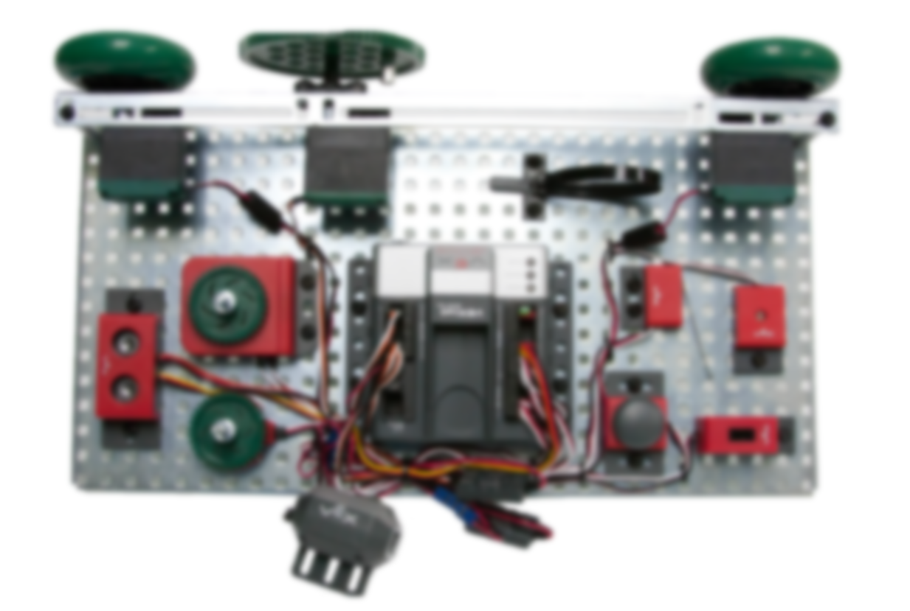
VEX Testbed
Photos and Sensor Instructions
Learn about Vex Sensors

Slide 2
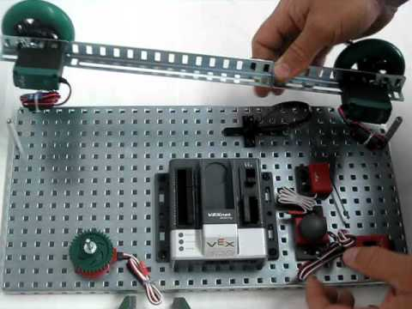
VEX Testbed
Please open to page 23 in your packet.
Use the VEX Testbed powerpoint on Edmodo to help you fill out the questions on pages 23-25.

Slide 3
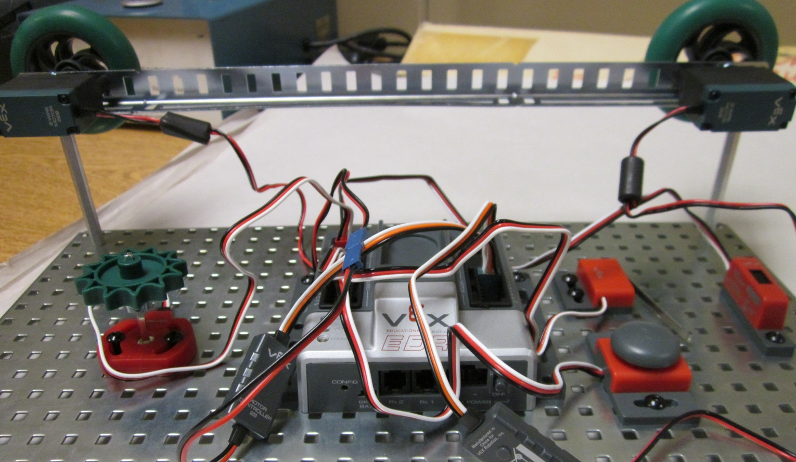
VEX Testbed
SENSORS
We will use the motors and sensors in your toolkit to build the testbed
MOTORS

Slide 4
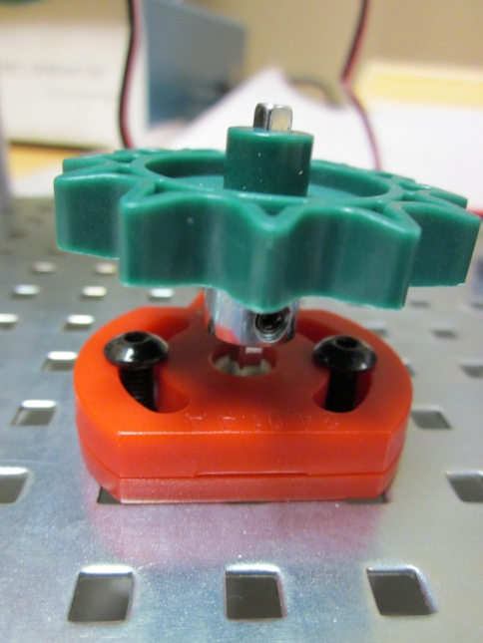
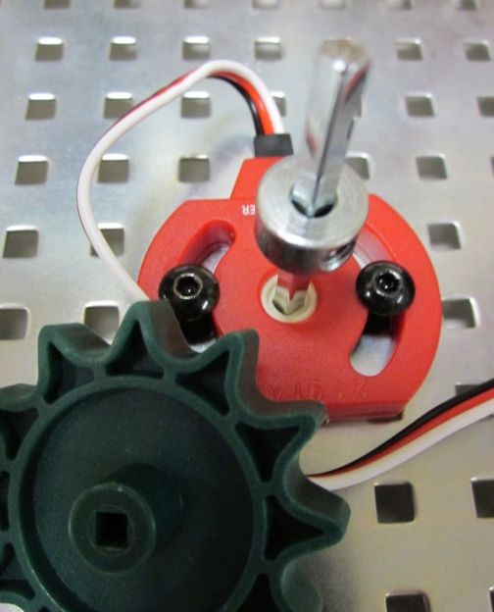
Sensor Arrangement
To the right of the cortex, attach the limit switch, bump switch, and line tracker
To the left of the cortex, attach the potentiometer and place any type of gear on the top

Slide 5
VEX Cortex
The cortex is the ‘brain’ of all our builds and also the costliest piece of equipment we use. Please treat it with care.

Slide 6
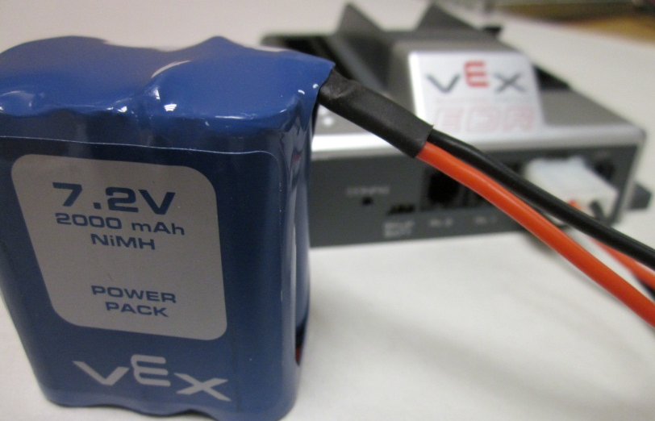
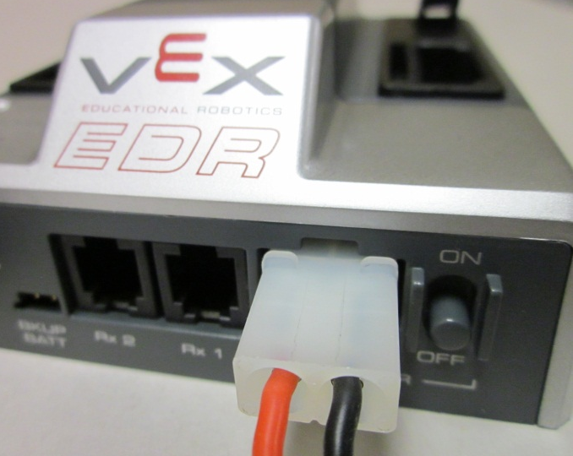
VEX Cortex
All of our robotic systems are battery powered. The battery plugs in the end of the cortex next to the ON/OFF switch

Slide 7
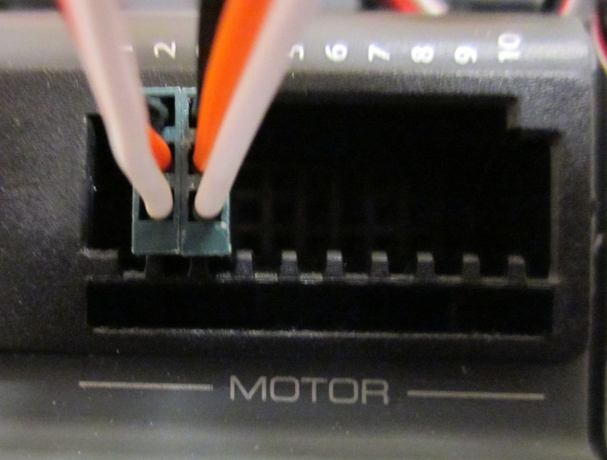
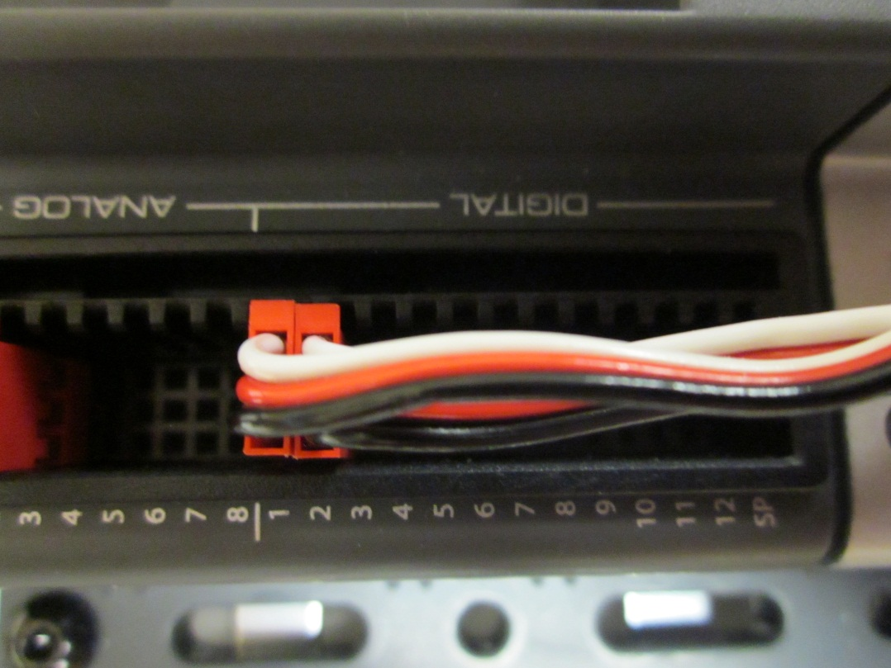
VEX Cortex - Sensors
The right side of the cortex has “MOTOR INPUTS”
The left side of the cortex has digital and analog “SENSOR INPUTS”

Slide 8
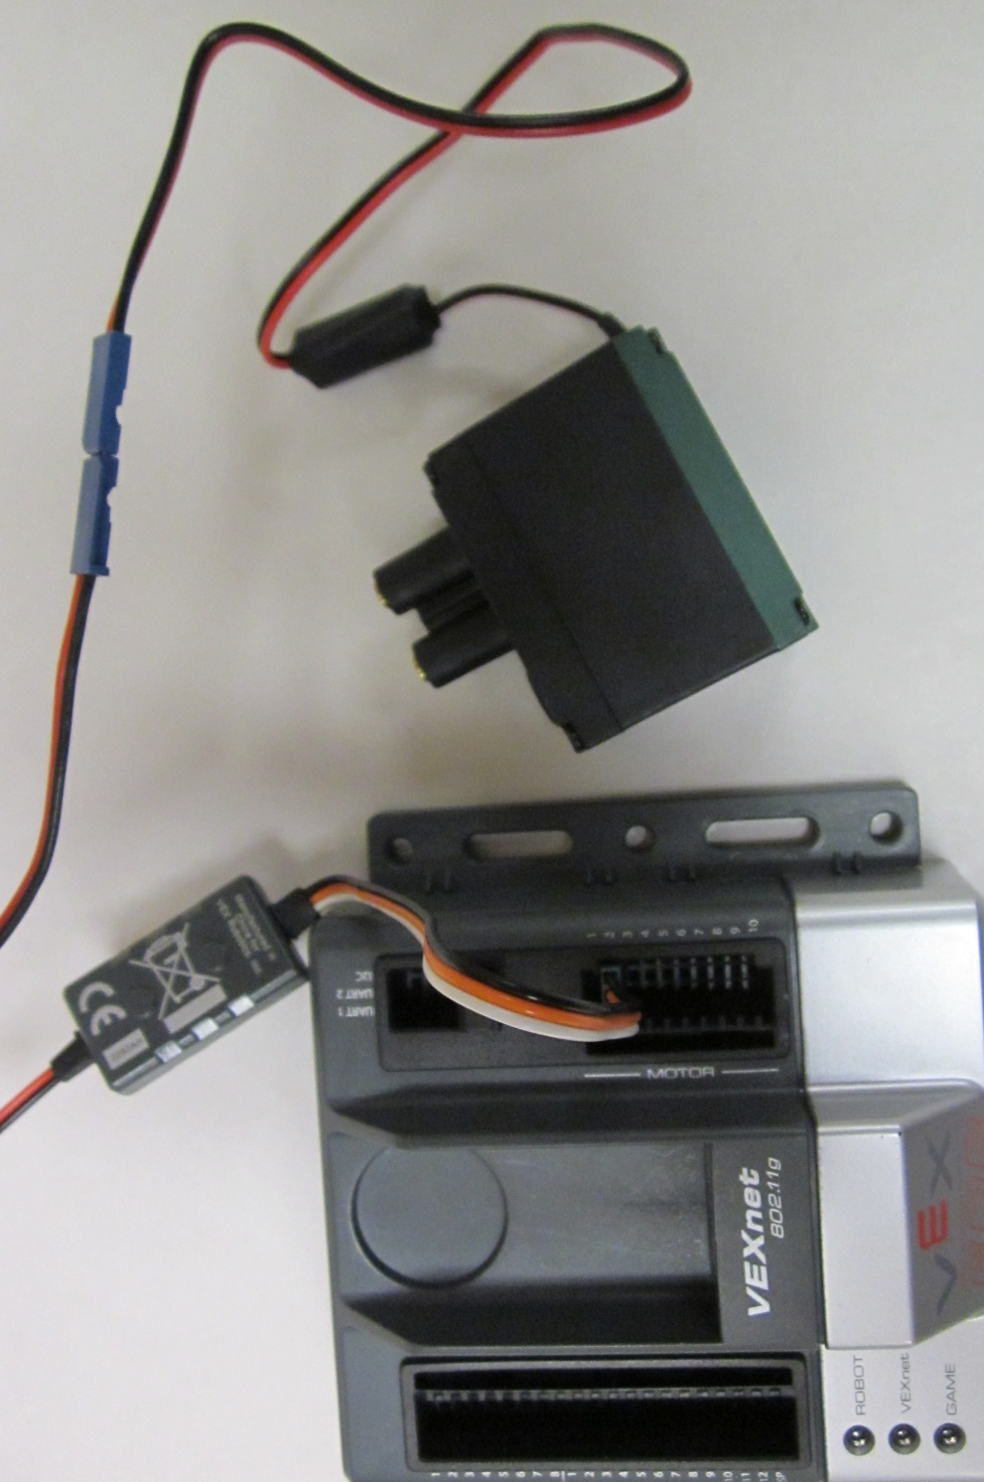
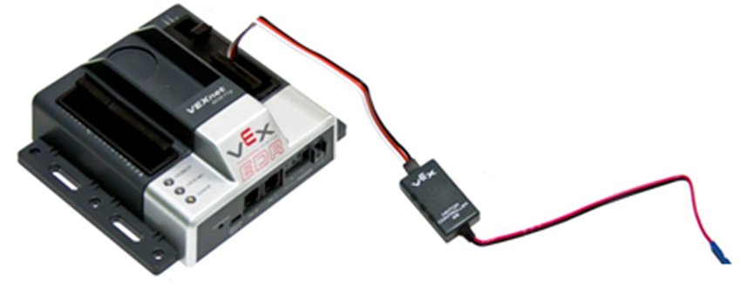
VEX Cortex - Motors
First let’s hook up a motor.
You need to use a “MOTOR CONTROLLER” whenever you connect a motor to the cortex. (To convert 2 wires into 3)

Slide 9
VEX Cortex - Motors
Use ports 2 or 3 for motor connections
# 1 is for the CLAW!
#2 is for the RIGHT motor
#3 is for the LEFT motor
Notice the Black wire plugs in next to the numbers

Slide 10
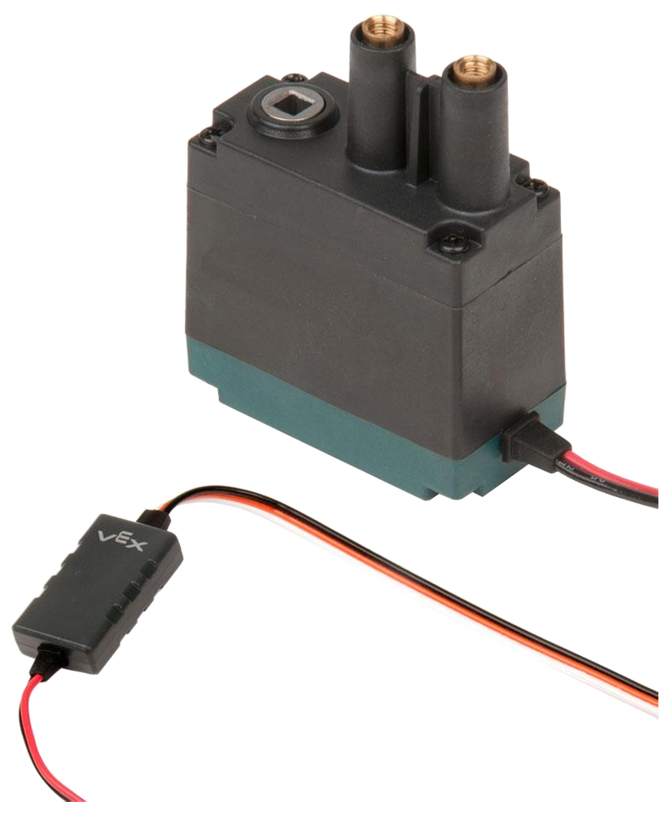
Motors
The motors are used to turn any axle attached to it. They are able to move in both forward and reverse directions.
You need to use MOTOR SCREWS to attach the motors to your build.
Code for motors might look something like this:

Slide 11
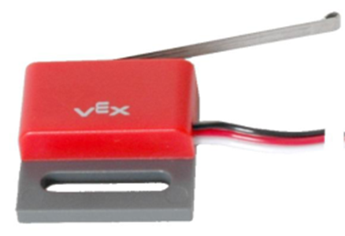
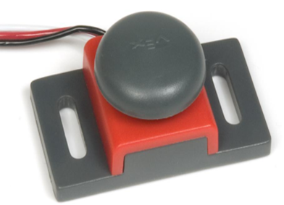
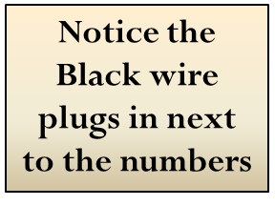
VEX Cortex – Digital Sensors
Digital Sensors include:
Limit Switch (Port 1)
Bump Switch (Port 2)
LED lights (Next Slide)

Slide 12
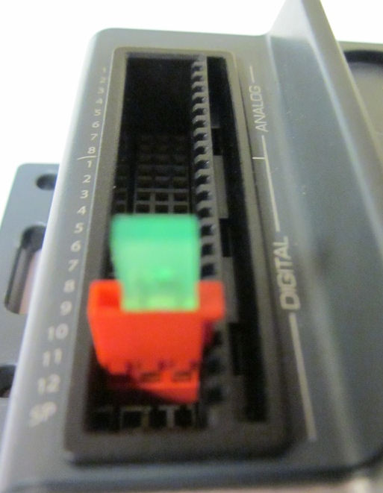
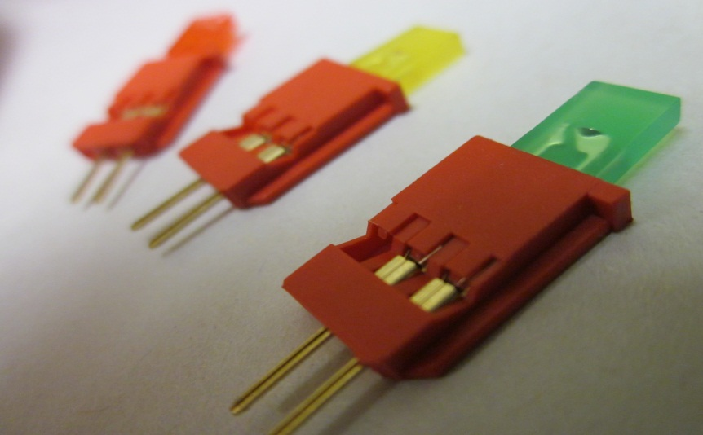
VEX Cortex – Digital Sensors
Digital Sensors include:
Limit Switch (Port 1)
Bump Switch (Port 2)
LED lights (Port 12)

Slide 13
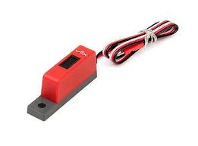
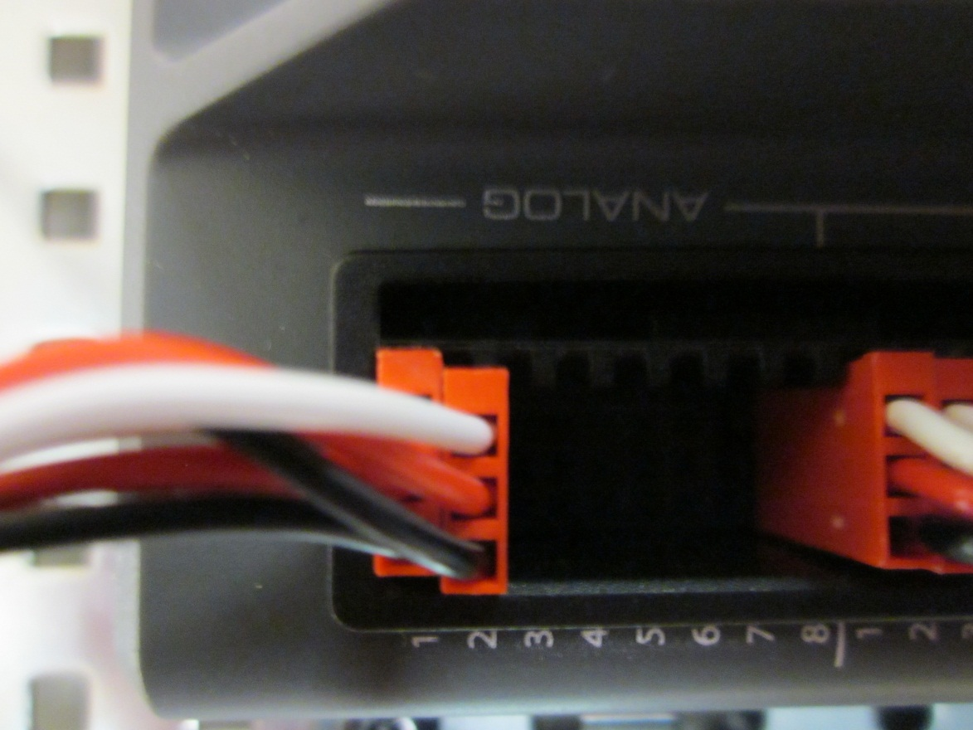
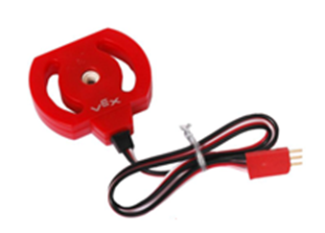
VEX Cortex – Analog Sensors
Analog Sensors include:
Line Tracker (Port 1)
Potentiometer (Port 2)

Slide 14
Limit Switch – Digital Port 1
The limit Switch can be used to trigger an action when it is pressed. This can include:
Start
Stop
Wait
A code using the limit switch would look like:

Slide 15
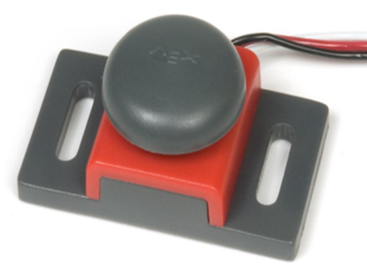
Bump Switch – Digital Port 2
The bump Switch can be used to trigger an action when it is pressed. This can include:
Start
Stop
Wait
A code using the bump switch would look like:

Slide 16
LED (any color)– Digital Port 12
LED’s are lights! We have green, red, and yellow LED’s with our VEX kits
You need to use another switch to trigger the LED’s and turn them on or off
A code using the LED’s might look like:

Slide 17
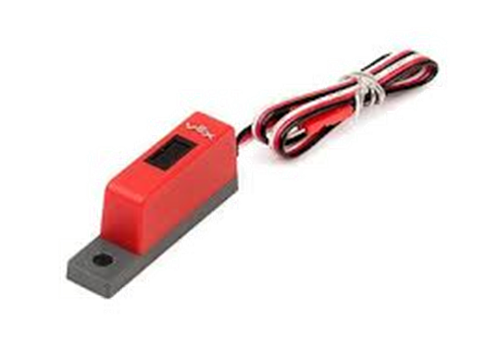
Line Tracker– Analog Port 1
The line tracker can be used to sense light and dark. Use this sensor to trigger other actions, such as
Start
Stop
Wait
Turn on/off LED’s
A code using the line tracker would look like:

Slide 18
Potentiometer– Analog Port 2
The Potentiometer can be used to sense movement in an arc. It does not move on its own, rather it needs to be connected to a motor.
CAUTION: It is very sensitive, do NOT force it to move or the internal parts will break.
A code using the Potentiometer would look like:

